Slide 1
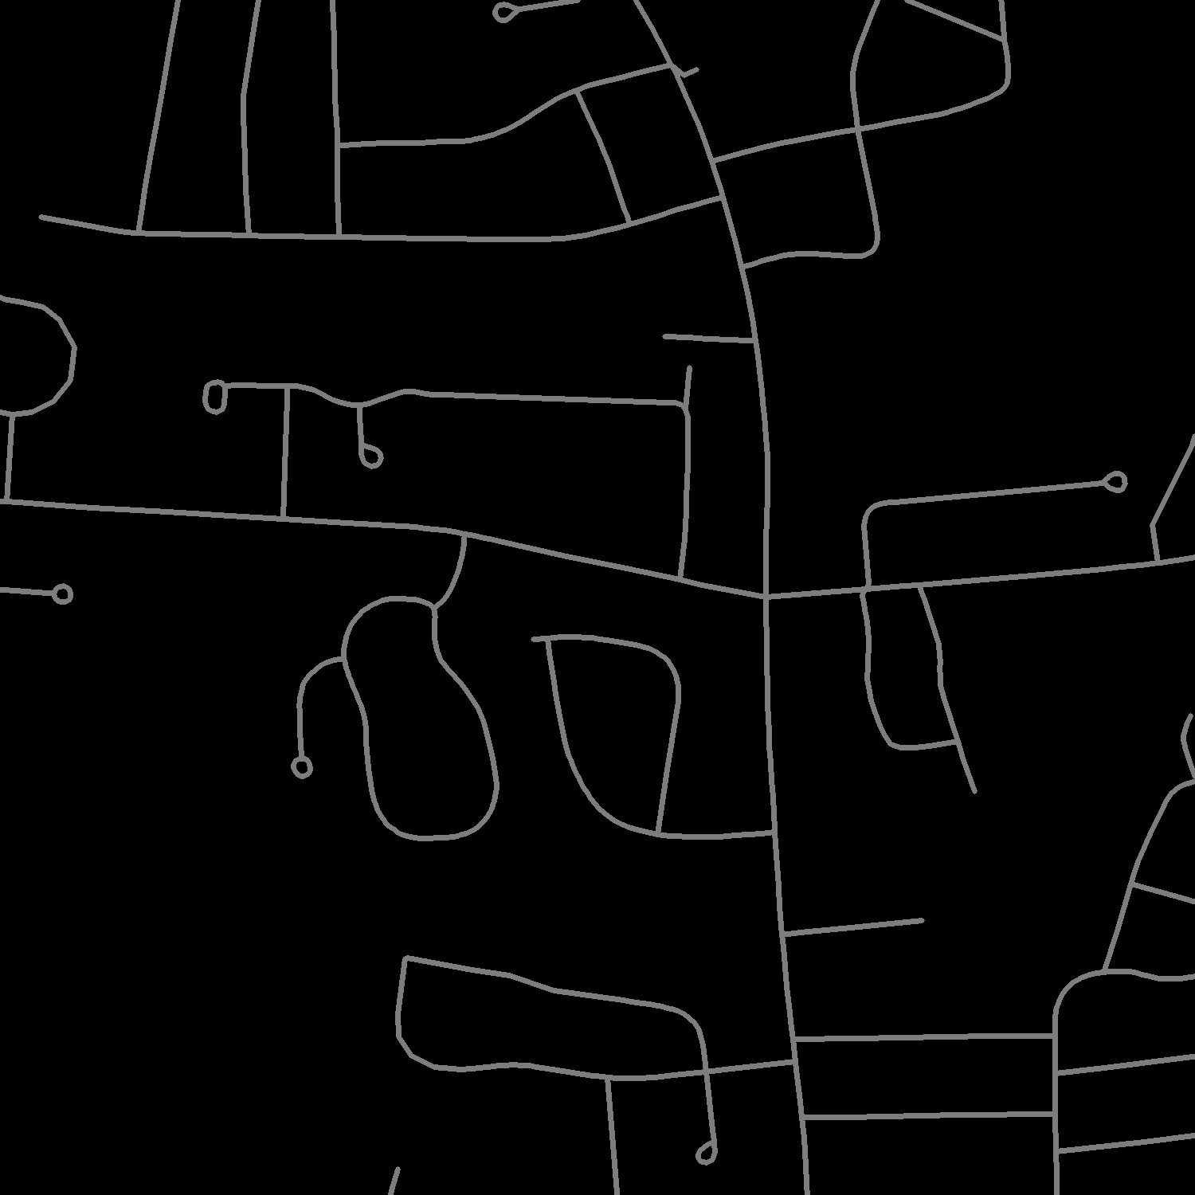
Построение графа дорожной системы по изображения со спутника
Кондренко Кирилл 21203
Шальнев Тимофей 21204
Новосибирский государственный университет
2024

Slide 2
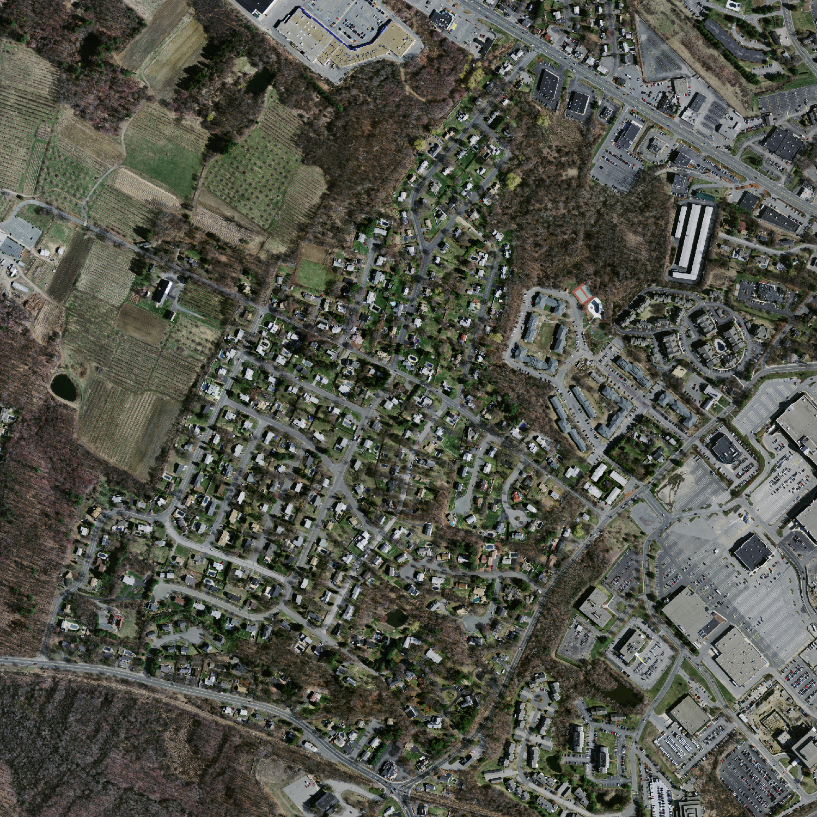
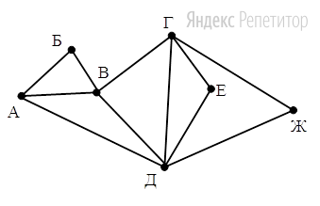
Problem

Slide 3
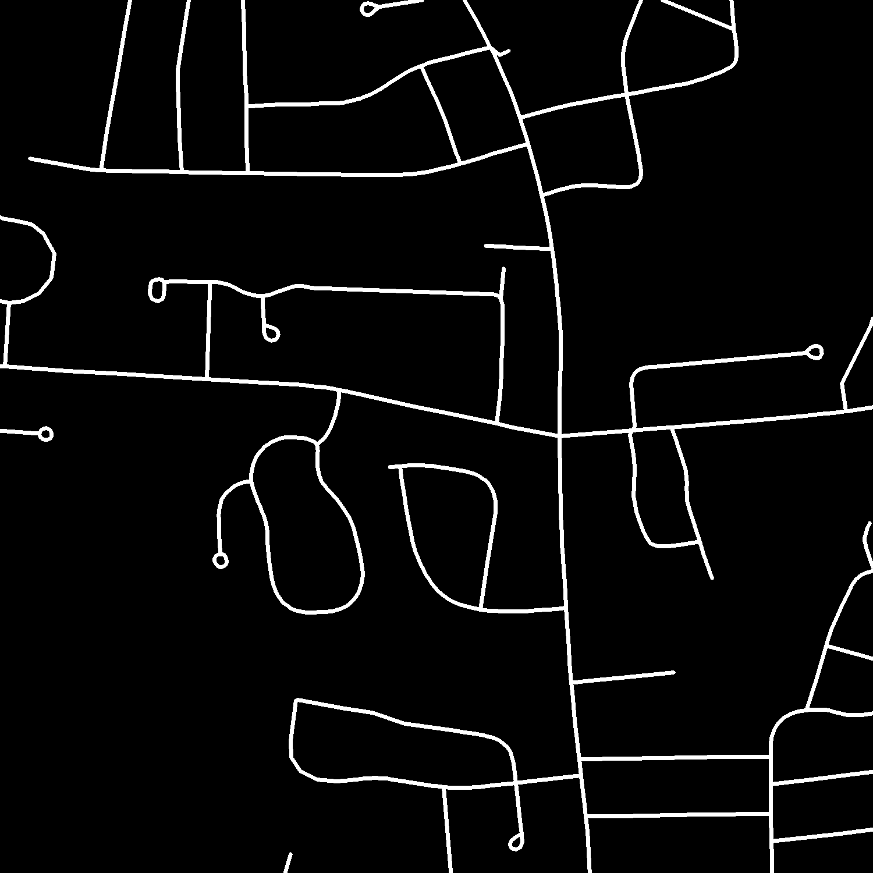
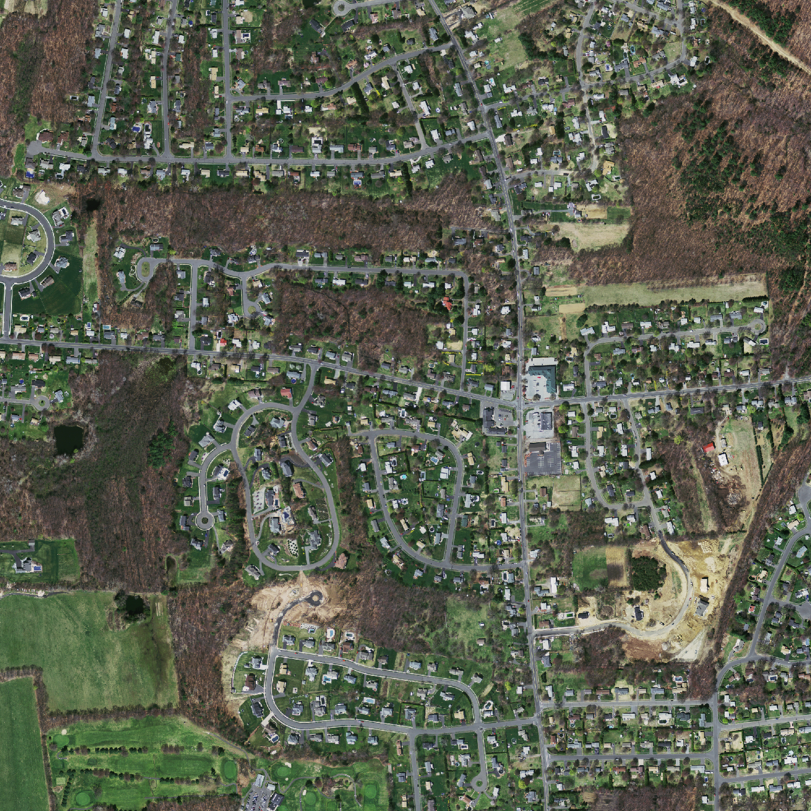
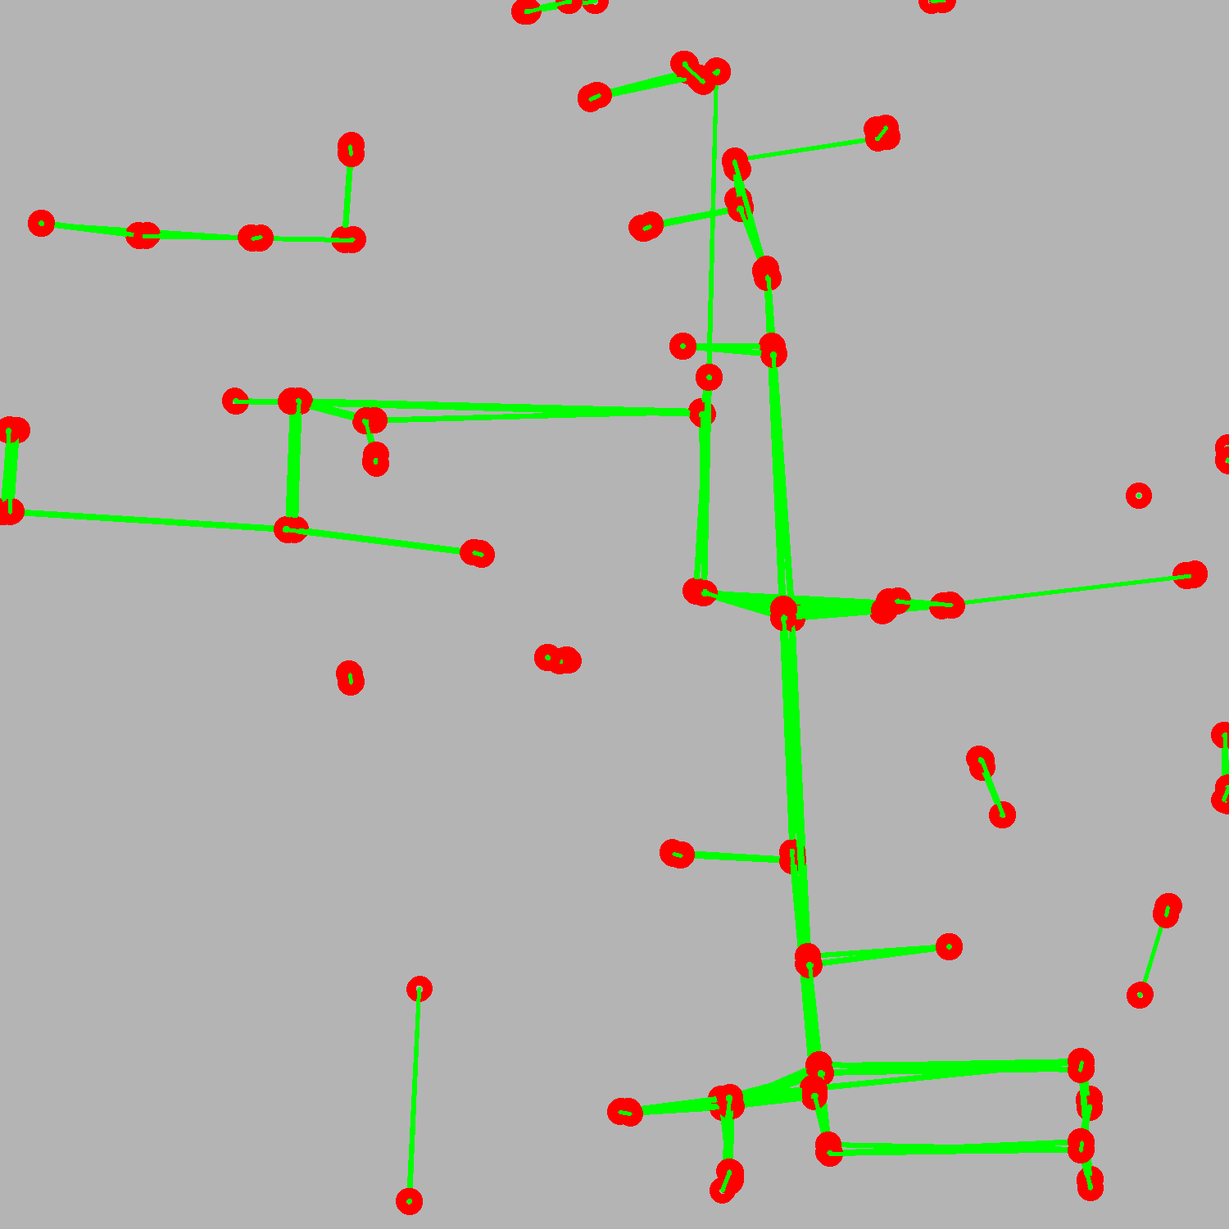
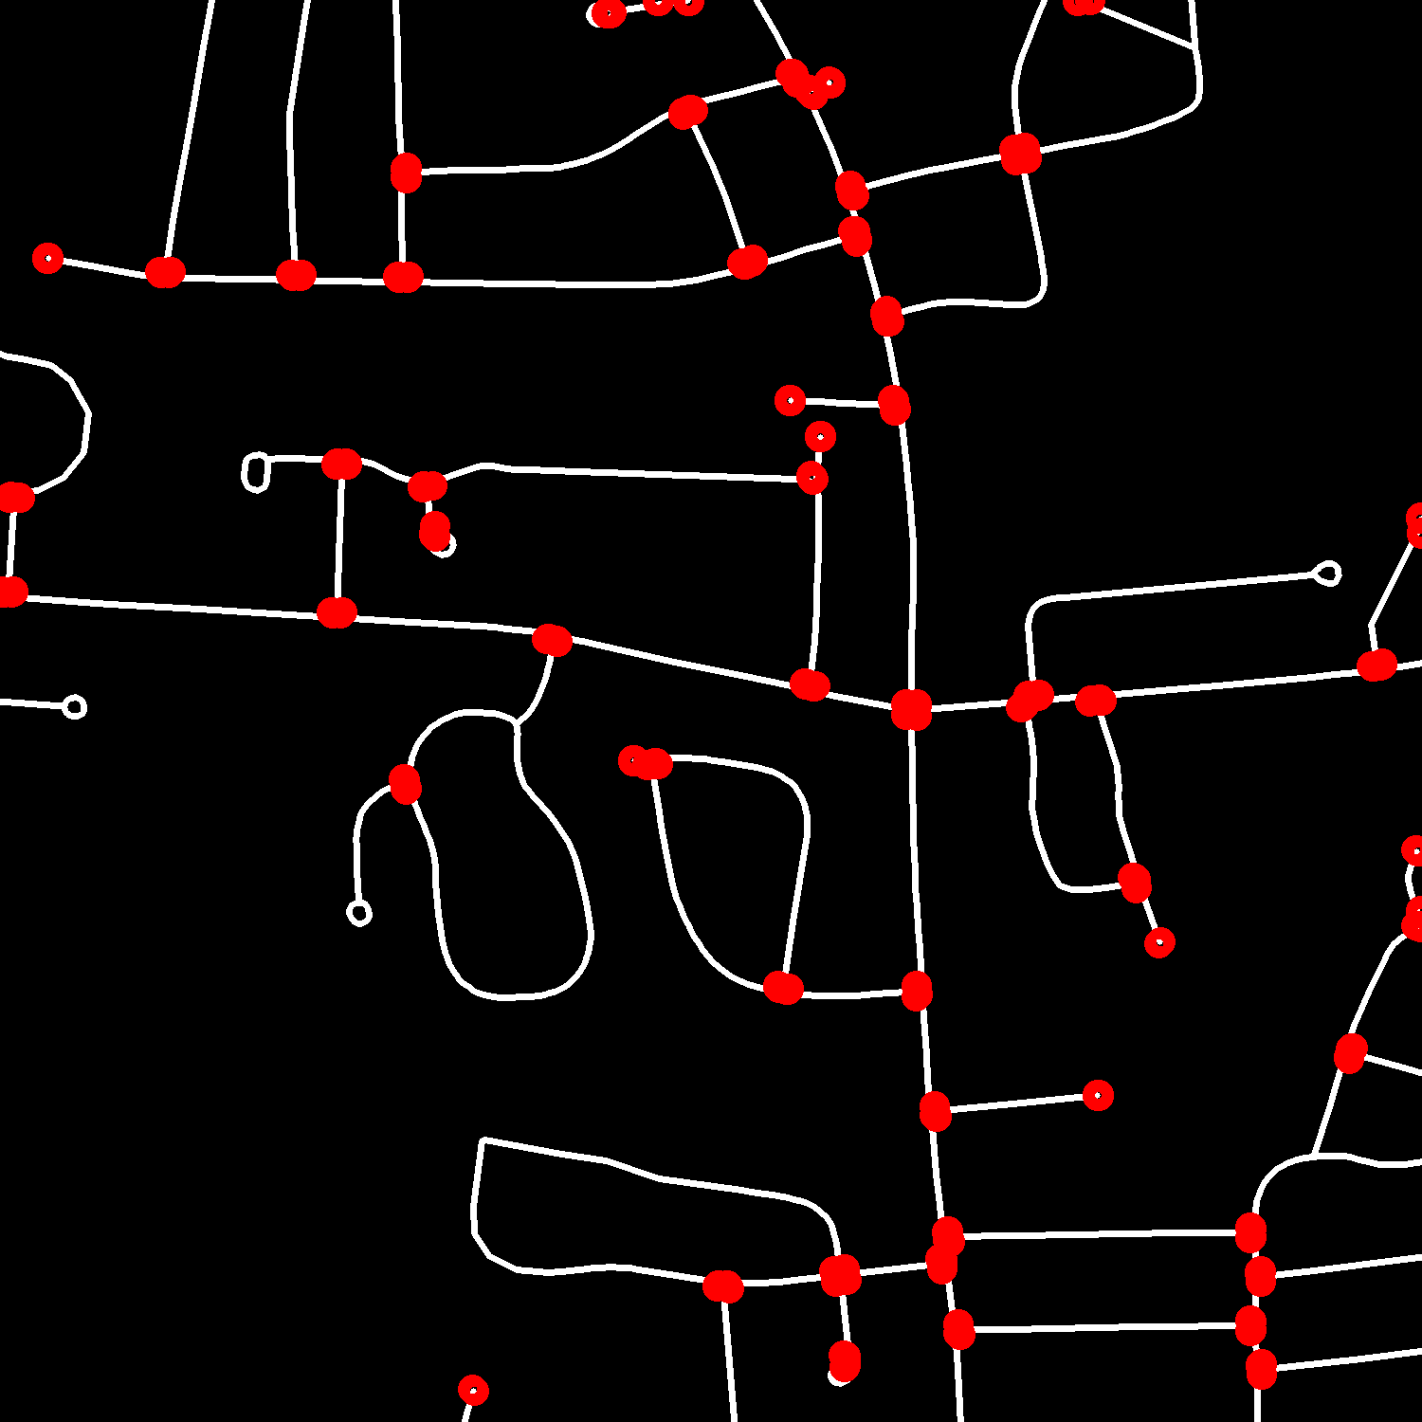
Pipeline
Binary Segmentation
Crossroads detection
Making a graph

Slide 4
Massachusetts Roads Dataset
@phdthesis{MnihThesis,
author = {Volodymyr Mnih},
title = {Machine Learning for Aerial Image Labeling},
school = {University of Toronto},
year = {2013}
}

Slide 5
Encoder
Binary Segmentation: UNet
Decoder
3x512x512
2x512x512
64x512x512
Block
Block
+
64x512x512
MaxPool
ConvTransposed
128x256x256
Block
64x256x256
Block
+
MaxPool
ConvTransposed
128x256x256
256x128x128
128x128x128
Block
Block
+
MaxPool
ConvTransposed
256x128x128
512x64x64
1024x64x64
256x64x64
Block
Block
Bottleneck
+
MaxPool
ConvTransposed
512x64x64
Conv, ReLu
Conv, ReLU
512x32x32
1024x32x32
1024x32x32

Slide 6
Block
Conv,
ReLU
Conv,
ReLU

Slide 7
Binary Segmentation: UNet
3x512x512
2x512x512
64x512x512
Block
Block
+
64x512x512
MaxPool
ConvTransposed
128x256x256
Block
64x256x256
Block
+
MaxPool
ConvTransposed
128x256x256
256x128x128
128x128x128
Block
Block
+
MaxPool
ConvTransposed
256x128x128
512x64x64
1024x64x64
256x64x64
Block
Block
+
MaxPool
ConvTransposed
512x64x64
Conv, ReLu
Conv, ReLU
512x32x32
1024x32x32
1024x32x32

Slide 8
Binary Segmentation: UNet
3x512x512
2x512x512
64x512x512
Block
Block
+
64x512x512
MaxPool
ConvTransposed
128x256x256
Block
64x256x256
Block
+
MaxPool
ConvTransposed
128x256x256
256x128x128
128x128x128
Block
Block
+
MaxPool
ConvTransposed
256x128x128
512x64x64
1024x64x64
256x64x64
Block
Block
+
MaxPool
ConvTransposed
512x64x64
Conv, ReLu
Conv, ReLU
512x32x32
1024x32x32
1024x32x32

Slide 9
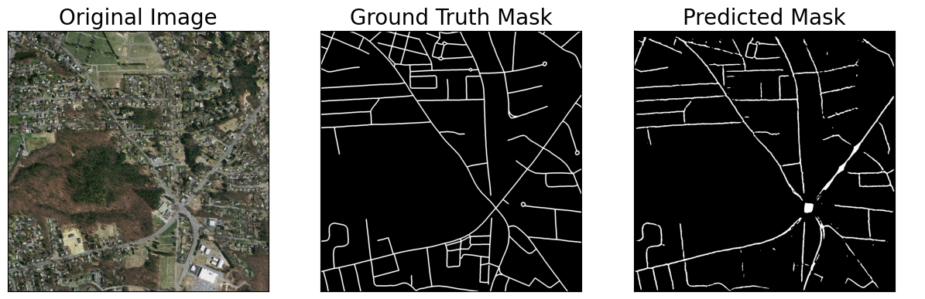
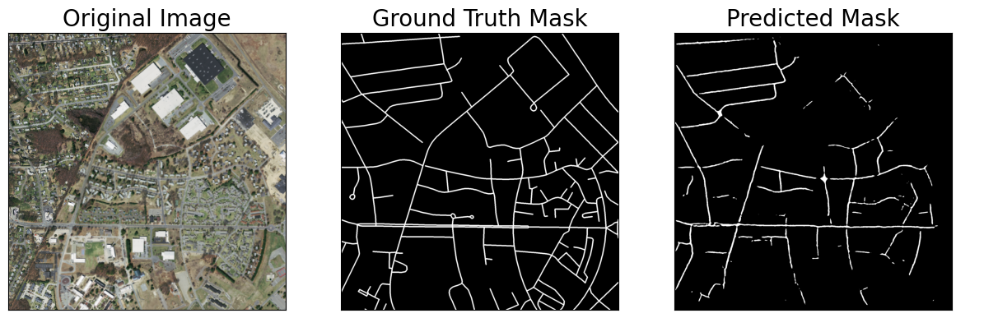

Slide 10
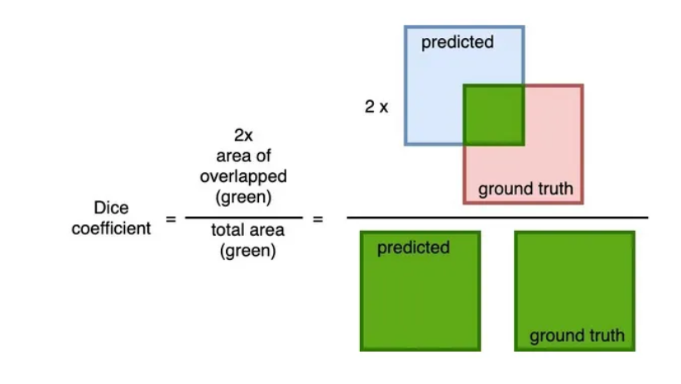
Dice loss is defined accordingly as 1 — Dice_Coefficient
https://cvinvolution.medium.com/dice-loss-in-medical-image-segmentation-d0e476eb486

Slide 11
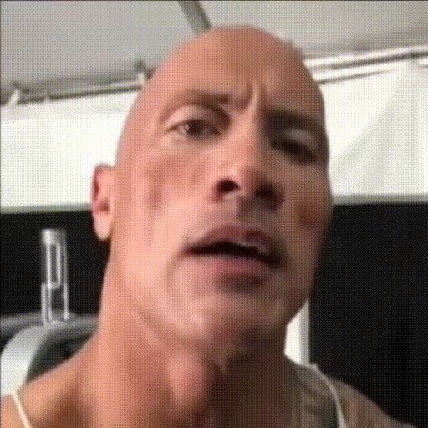

Slide 12
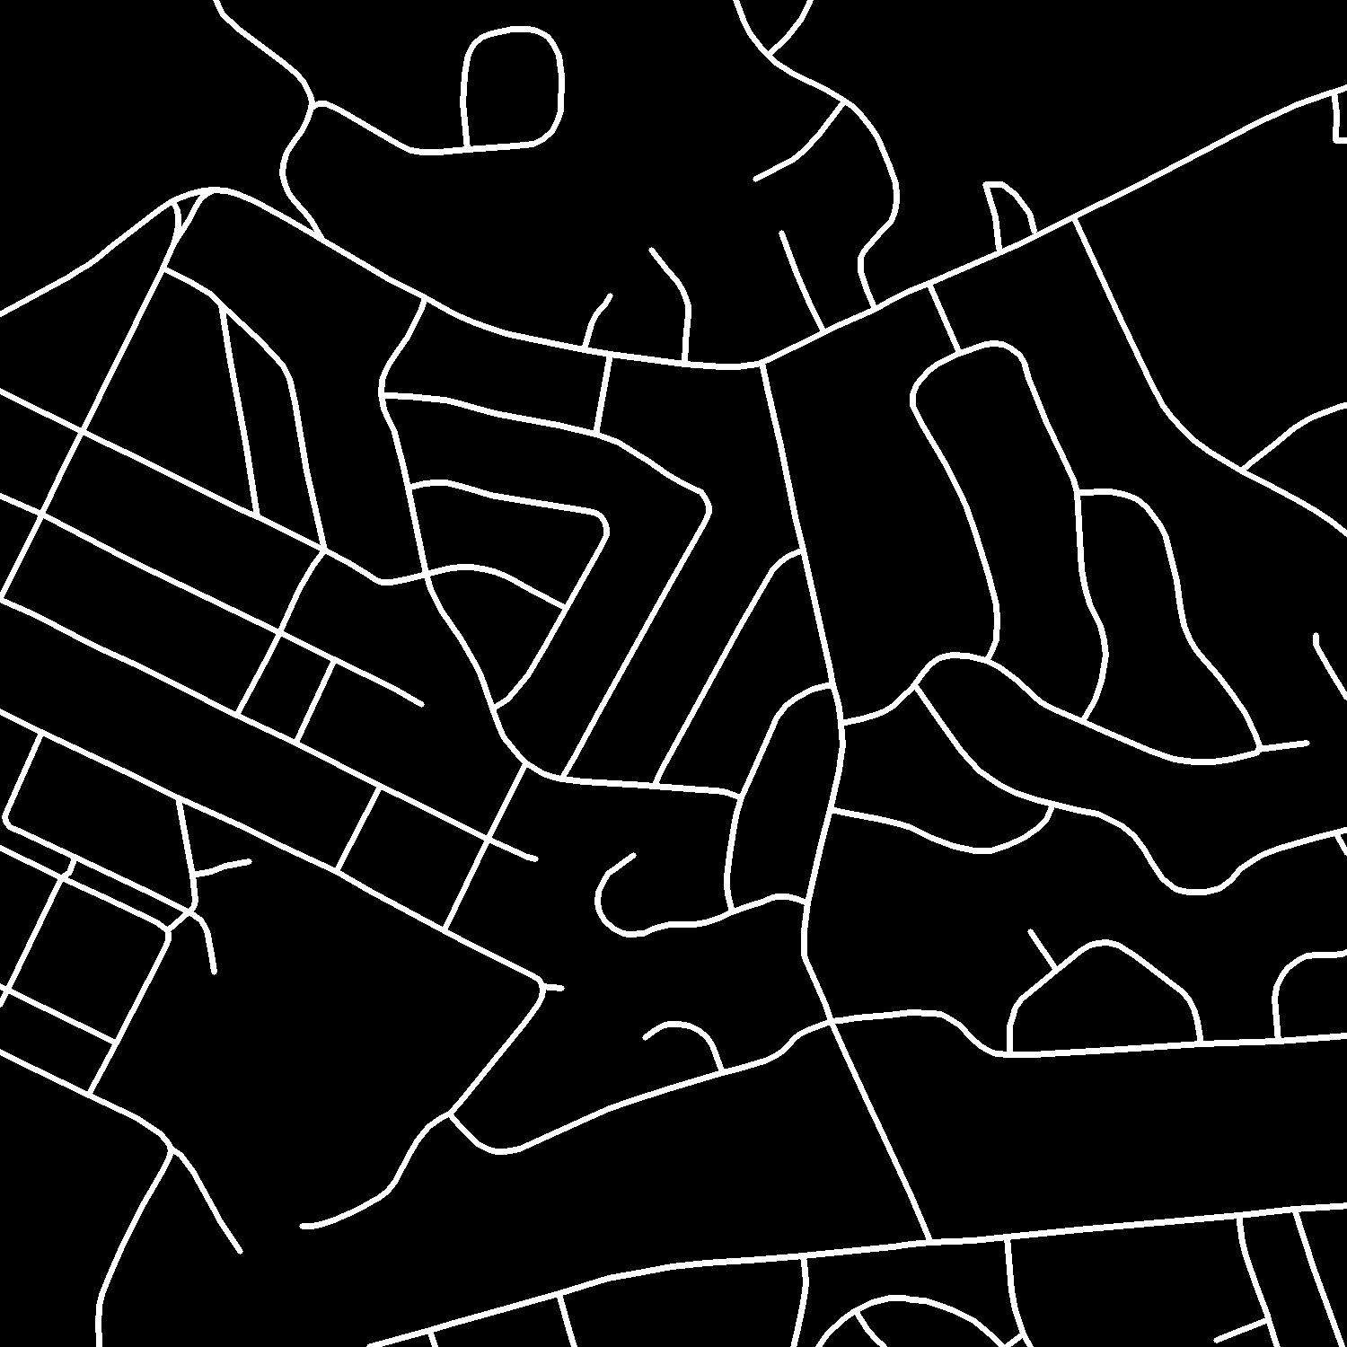
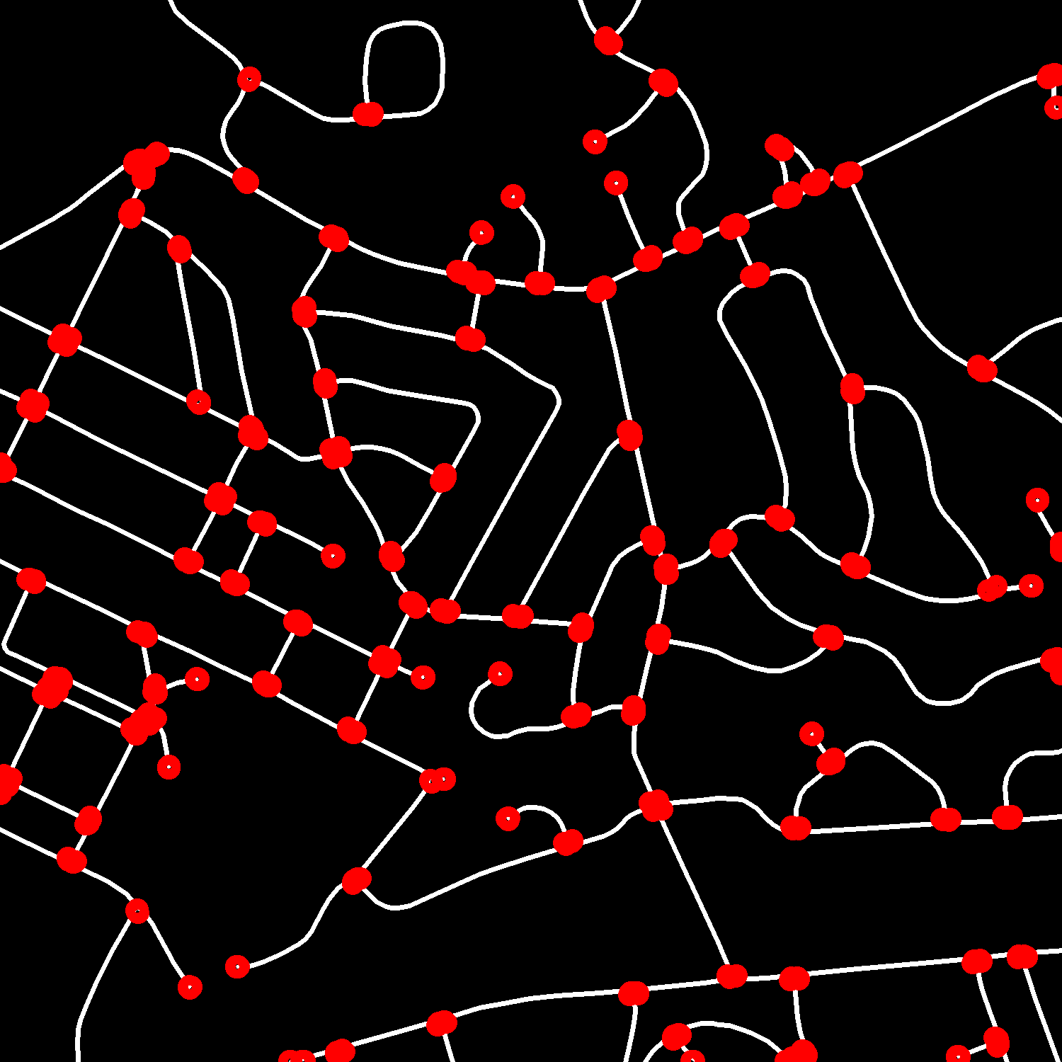
Crossroads detection: what we have and what we want

Slide 13
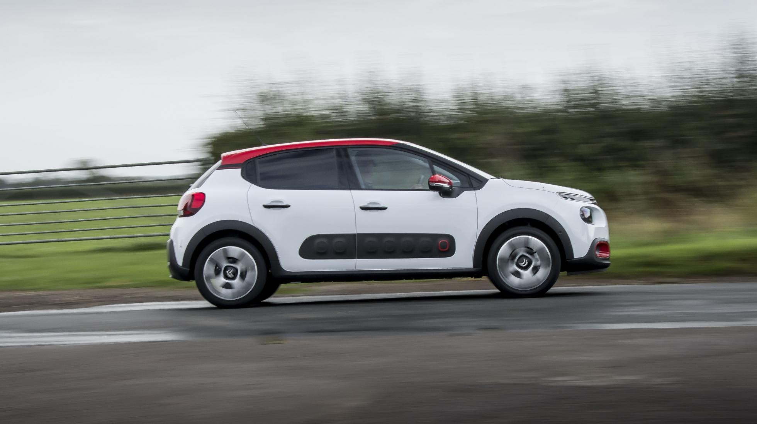
Crossroads detection: corner detector

Slide 14
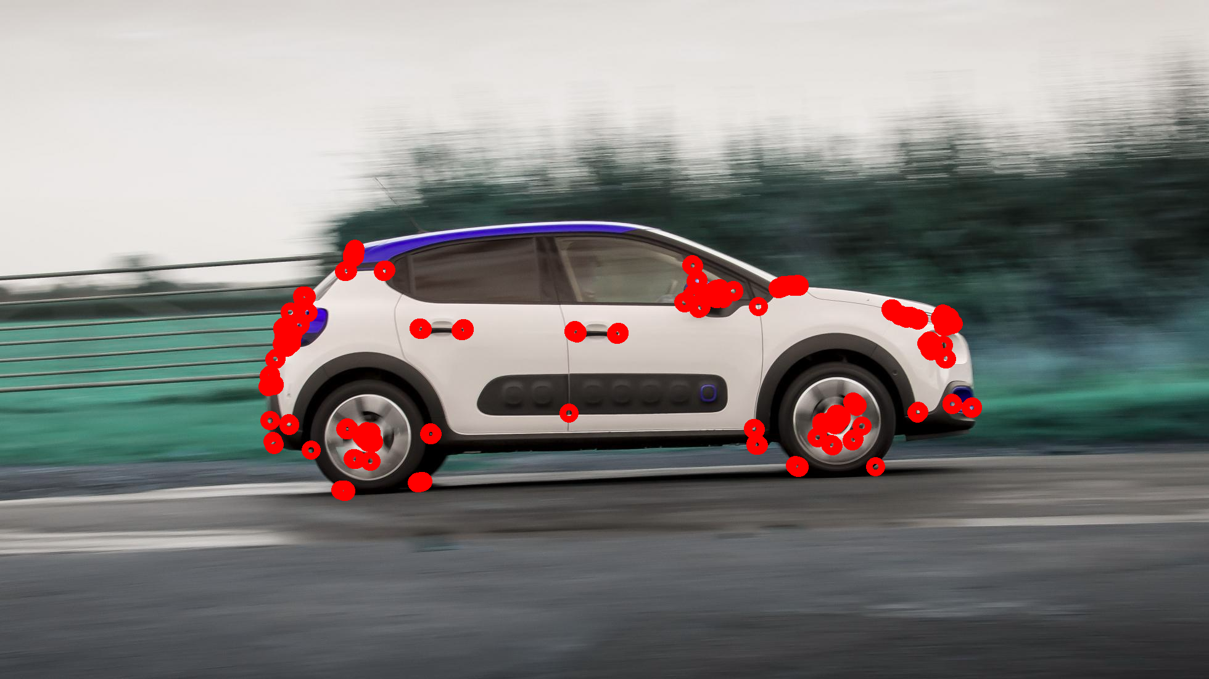
Crossroads detection: corner detector

Slide 15
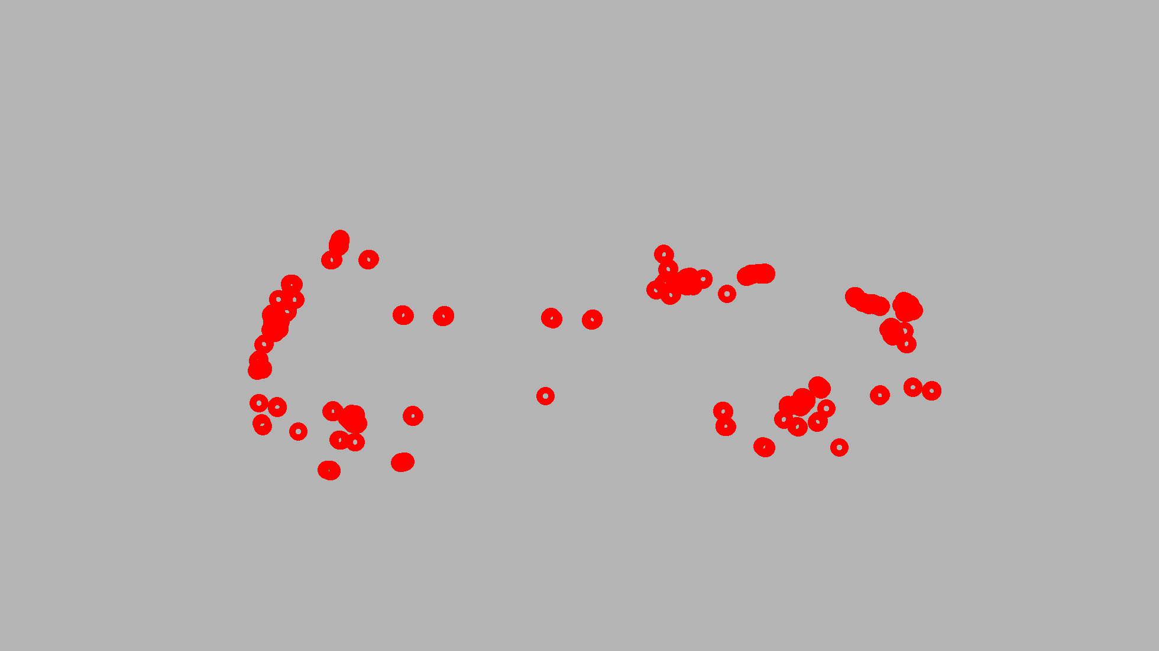
Crossroads detection: corner detector

Slide 16
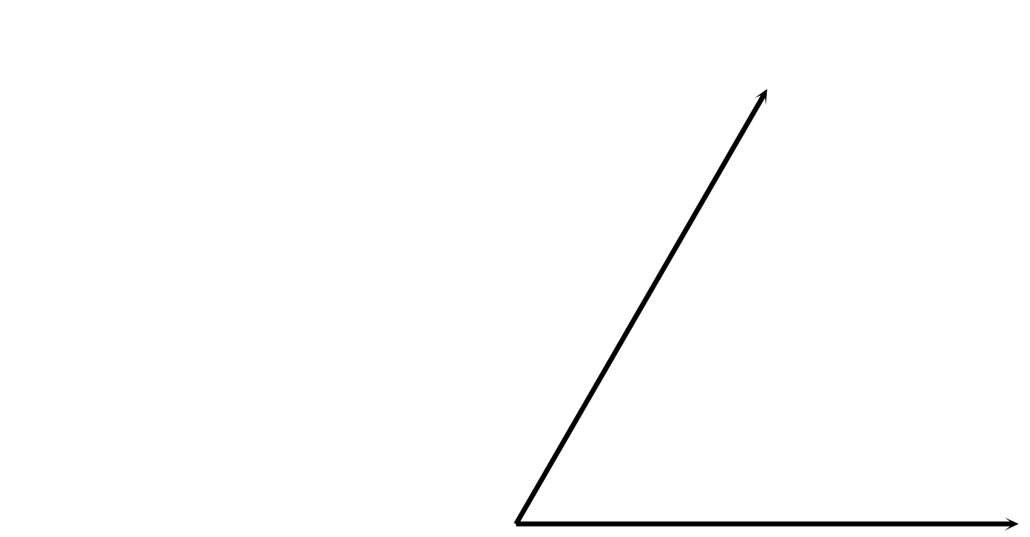
Crossroads detection: Harris corner detector

Slide 17
Crossroads detection: Harris corner detector approach

Slide 18
Crossroads detection: Harris corner detector approach

Slide 19
Crossroads detection: Harris corner detector approach

Slide 20
Crossroads detection: Harris corner detector approach

Slide 21
Crossroads detection: Harris corner detector approach

Slide 22
Crossroads detection: Harris corner detector approach

Slide 23
Crossroads detection: Harris corner detector approach
Idea: find points whose neighbors change greatly when shifted in any direction

Slide 24
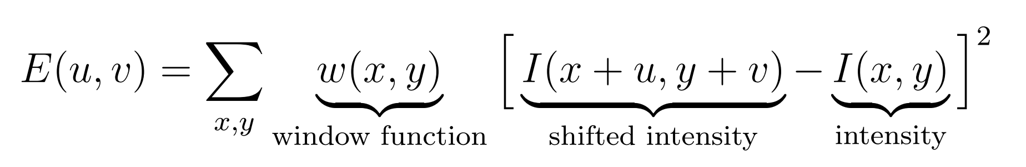
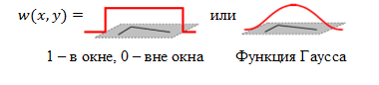
Crossroads detection: Harris corner detector

Slide 25
Crossroads detection: Harris corner detector
u, v

Slide 26
Crossroads detection: Harris corner detector
E(u, v) is large => it’s corner!

Slide 27
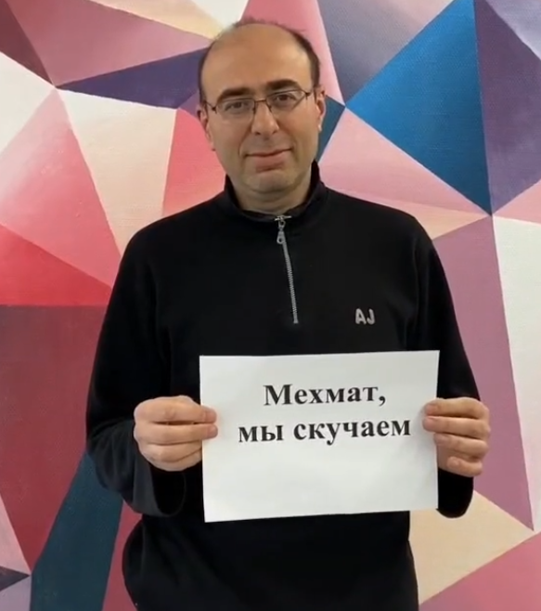

Crossroads detection: Harris corner detector
**some math magic happens**

Slide 28
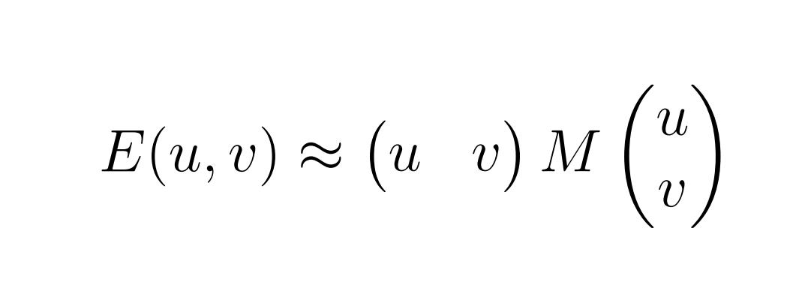
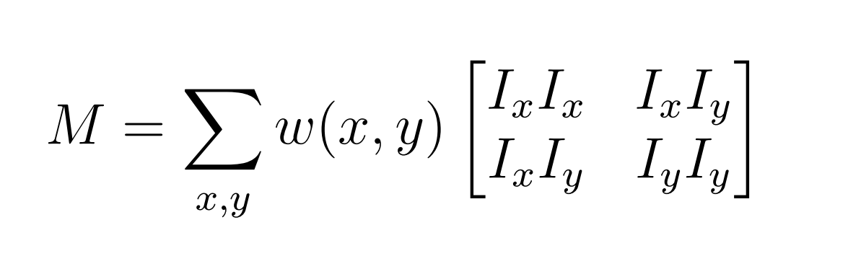
Crossroads detection: Harris corner detector

Slide 29

Crossroads detection: Harris corner detector
**some math magic happens**

Slide 30
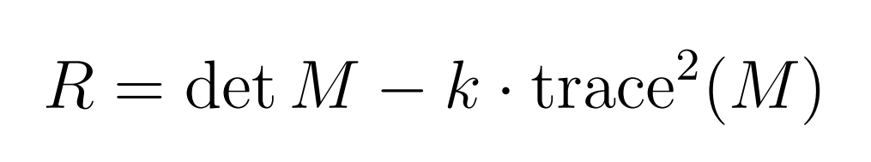
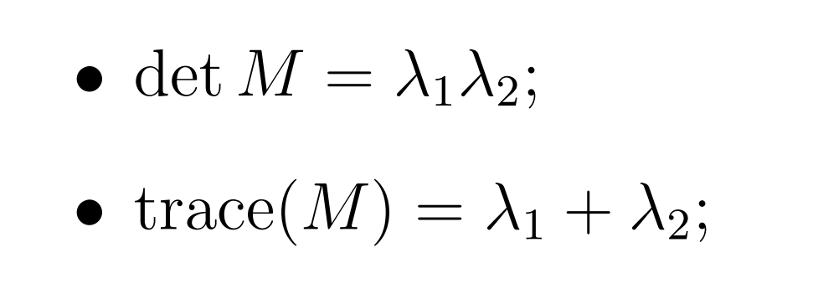
Crossroads detection: Harris corner detector

Slide 31
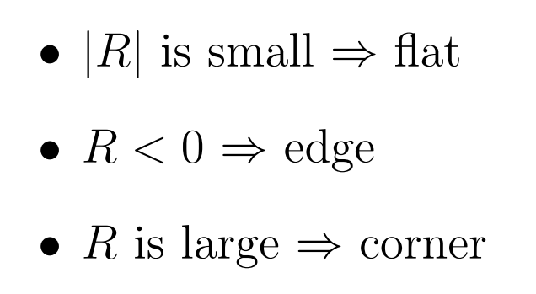
Crossroads detection: Harris corner detector

Slide 32
Crossroads detection: Harris corner detector
import cv2
image = cv2.imread(f"image.png")
image = cv2.cvtColor(image, cv2.COLOR_BGR2GRAY)
harris_result = cv2.cornerHarris(
src=image,
blockSize=3, # Size of neighborhood
ksize=9, # Sobel parameter
k=0.06 # Empirical
)

Slide 33
Crossroads detection: Harris corner detector
import networkx as nx
graph = nx.Graph()
height, width = harris_result.shape
THRESHOLD = 200
for y in range(height):
for x in range(width):
r = harris_result[y, x]
if r > THRESHOLD:
graph.add_node((x, y))

Slide 34
Crossroads detection: result

Slide 35
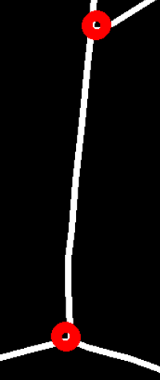
Making a graph

Slide 36
Making a graph
EDGE_THRESHOLD = 24
for i in range(len(graph.nodes)):
n1 = graph.nodes[i]
x1 = n1[0]
y1 = n1[1]
for j in range(i + 1, len(graph.nodes)):
n2 = graph.nodes[j]
x2 = n2[0]
y2 = n2[1]
min_x = min(x1, x2)
max_x = max(x1, x2)
min_y = min(y1, y2)
max_y = max(y1, y2)
intensity = image[min_y:max_y, min_x:max_x].sum()
size1 = max_x - min_x + 1
size2 = max_y - min_y + 1
area = size1 * size2
intensity /= area
if intensity > EDGE_THRESHOLD:
graph.add_edge(n1, n2)

Slide 37
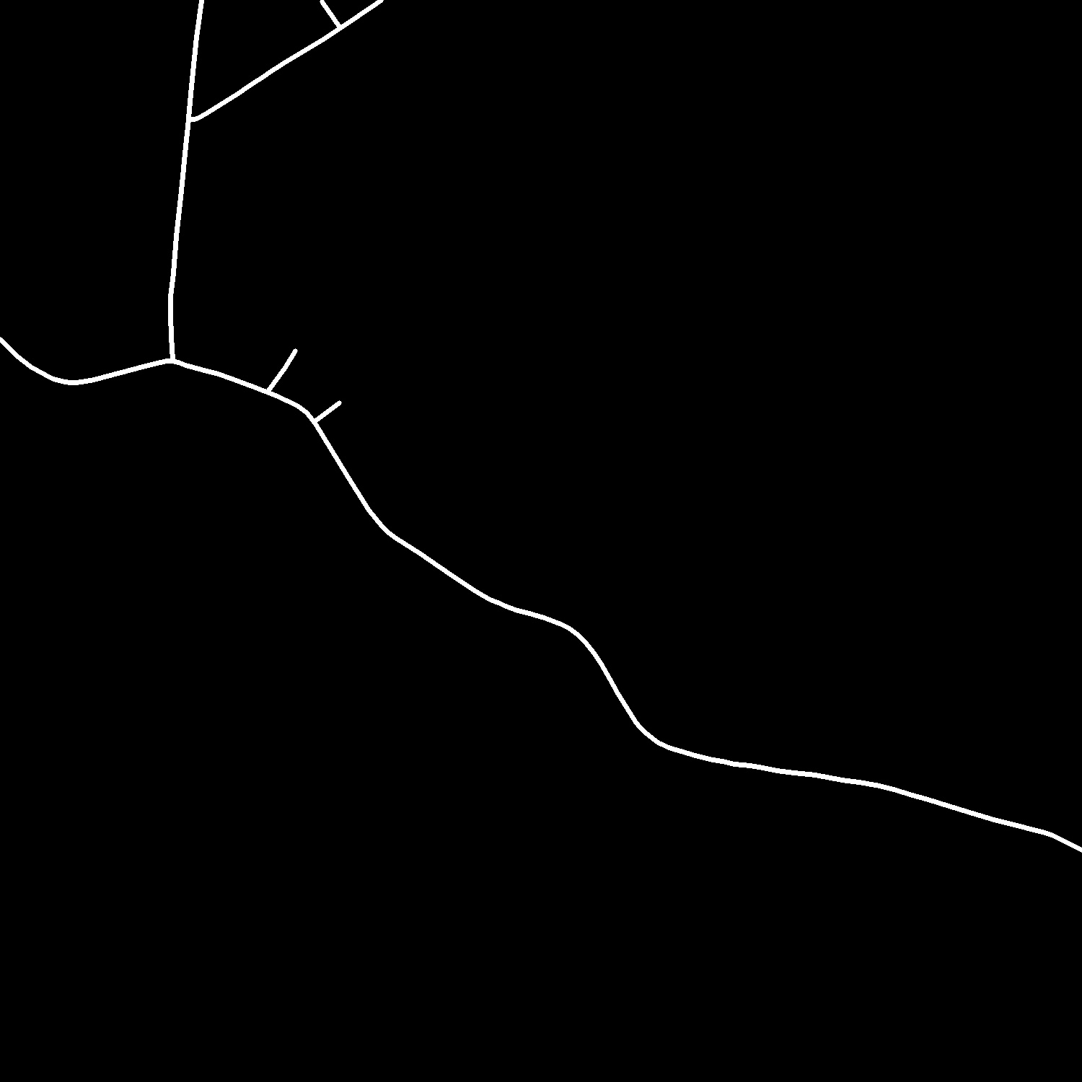
Crossroads detection + Making a graph: result-1

Slide 38
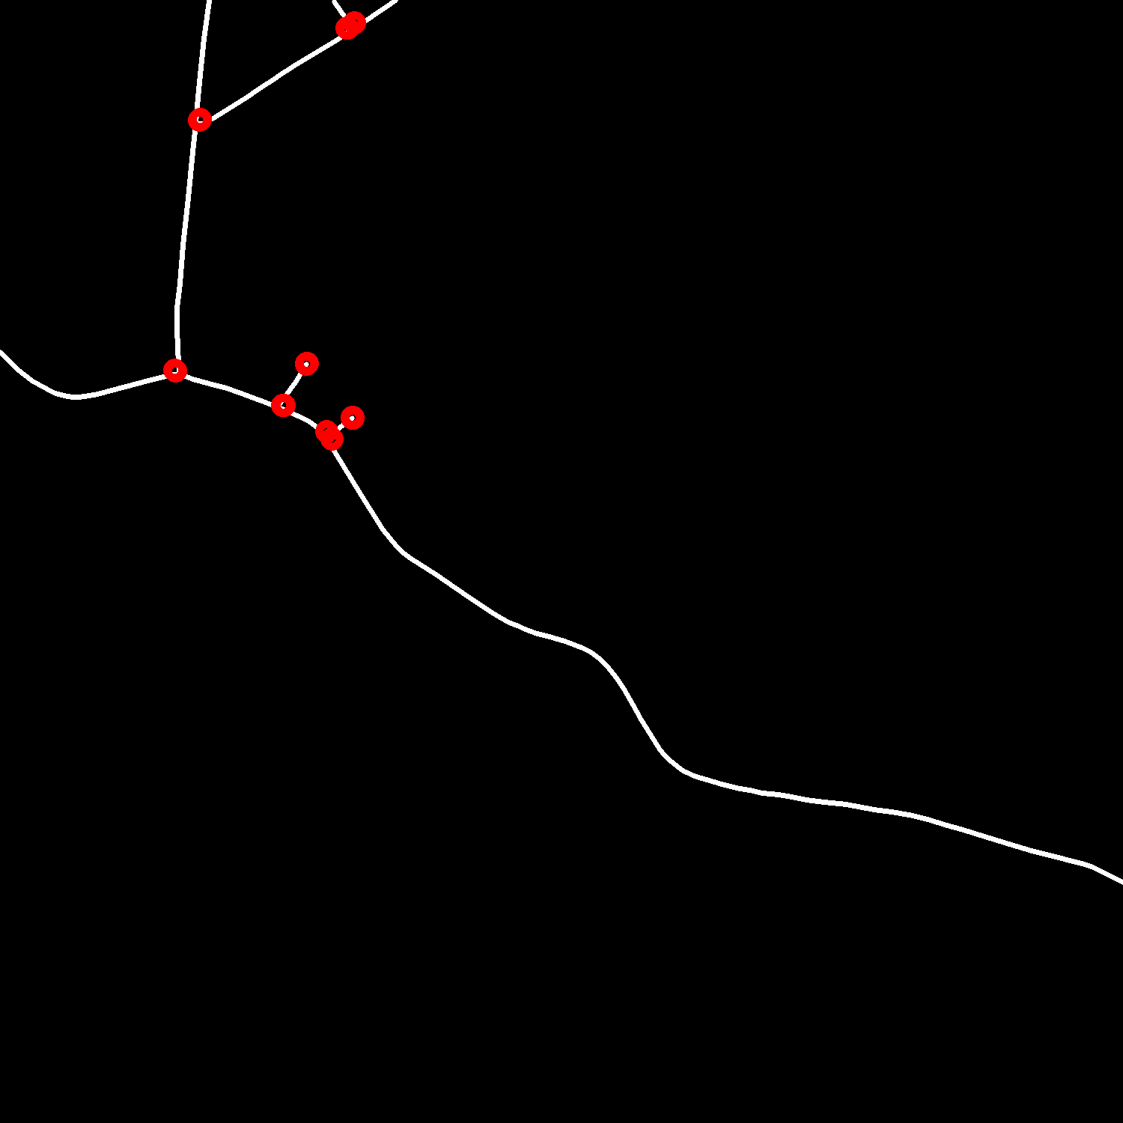
Crossroads detection + Making a graph: result-1

Slide 39
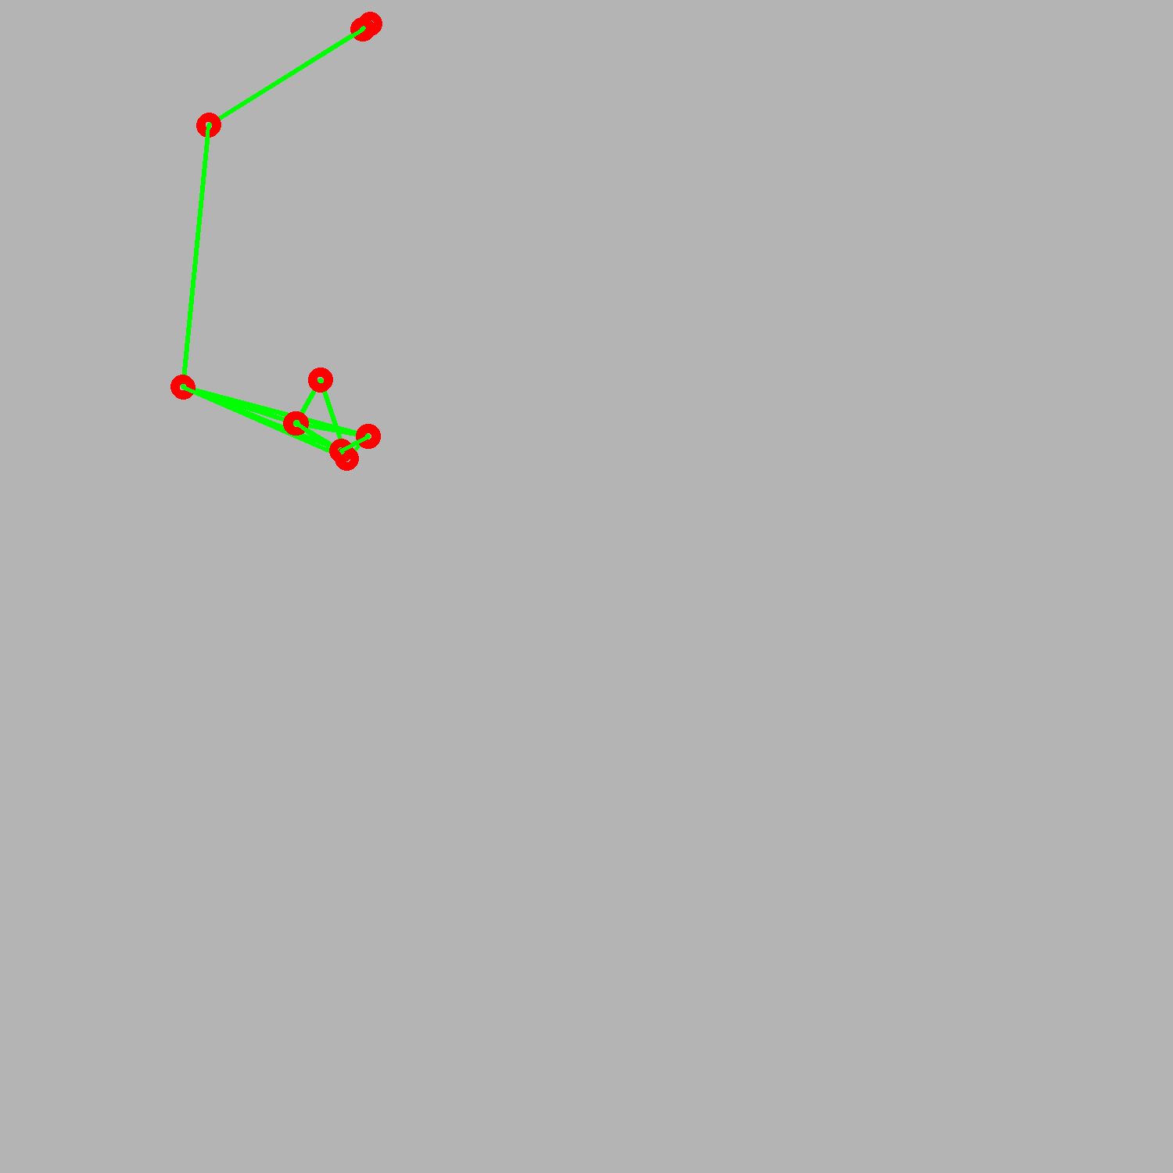
Crossroads detection + Making a graph: result-1

Slide 40
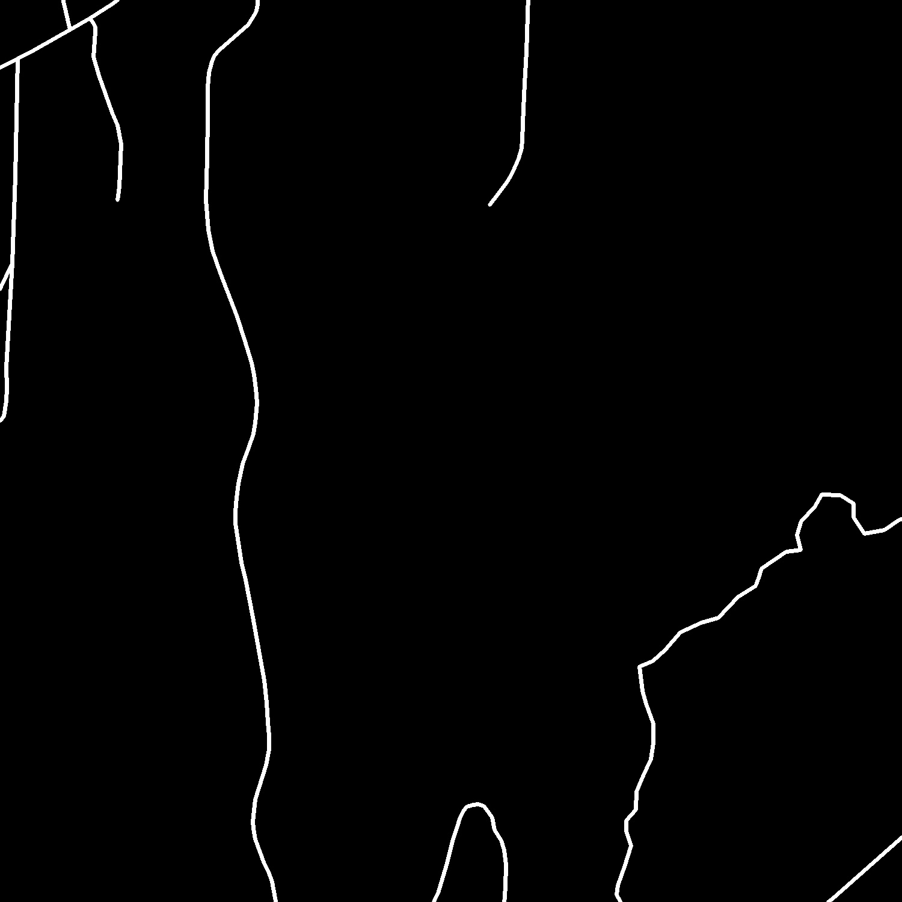
Crossroads detection + Making a graph: result-2

Slide 41
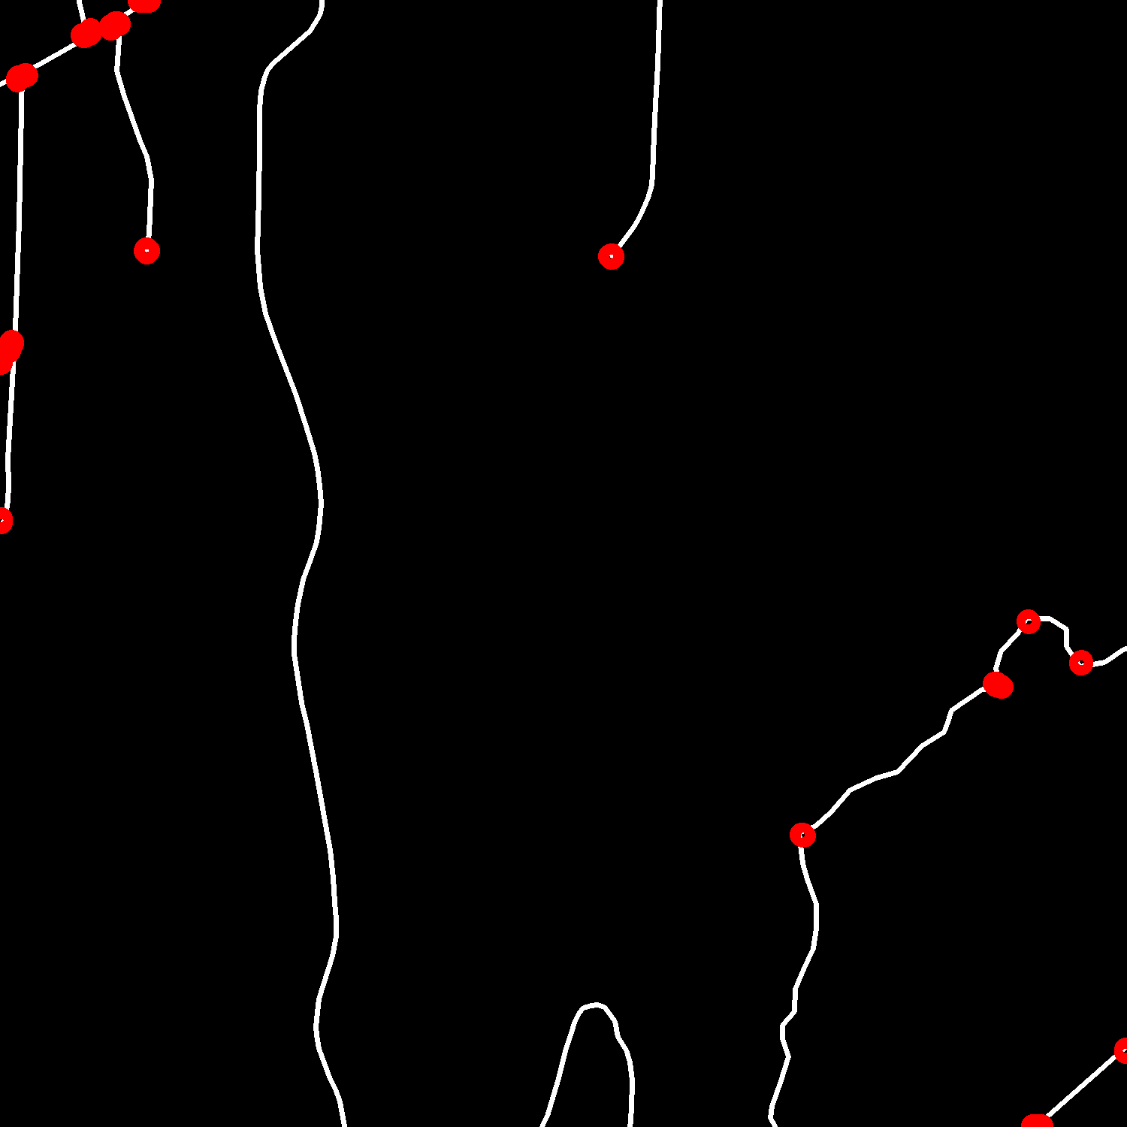
Crossroads detection + Making a graph: result-2

Slide 42
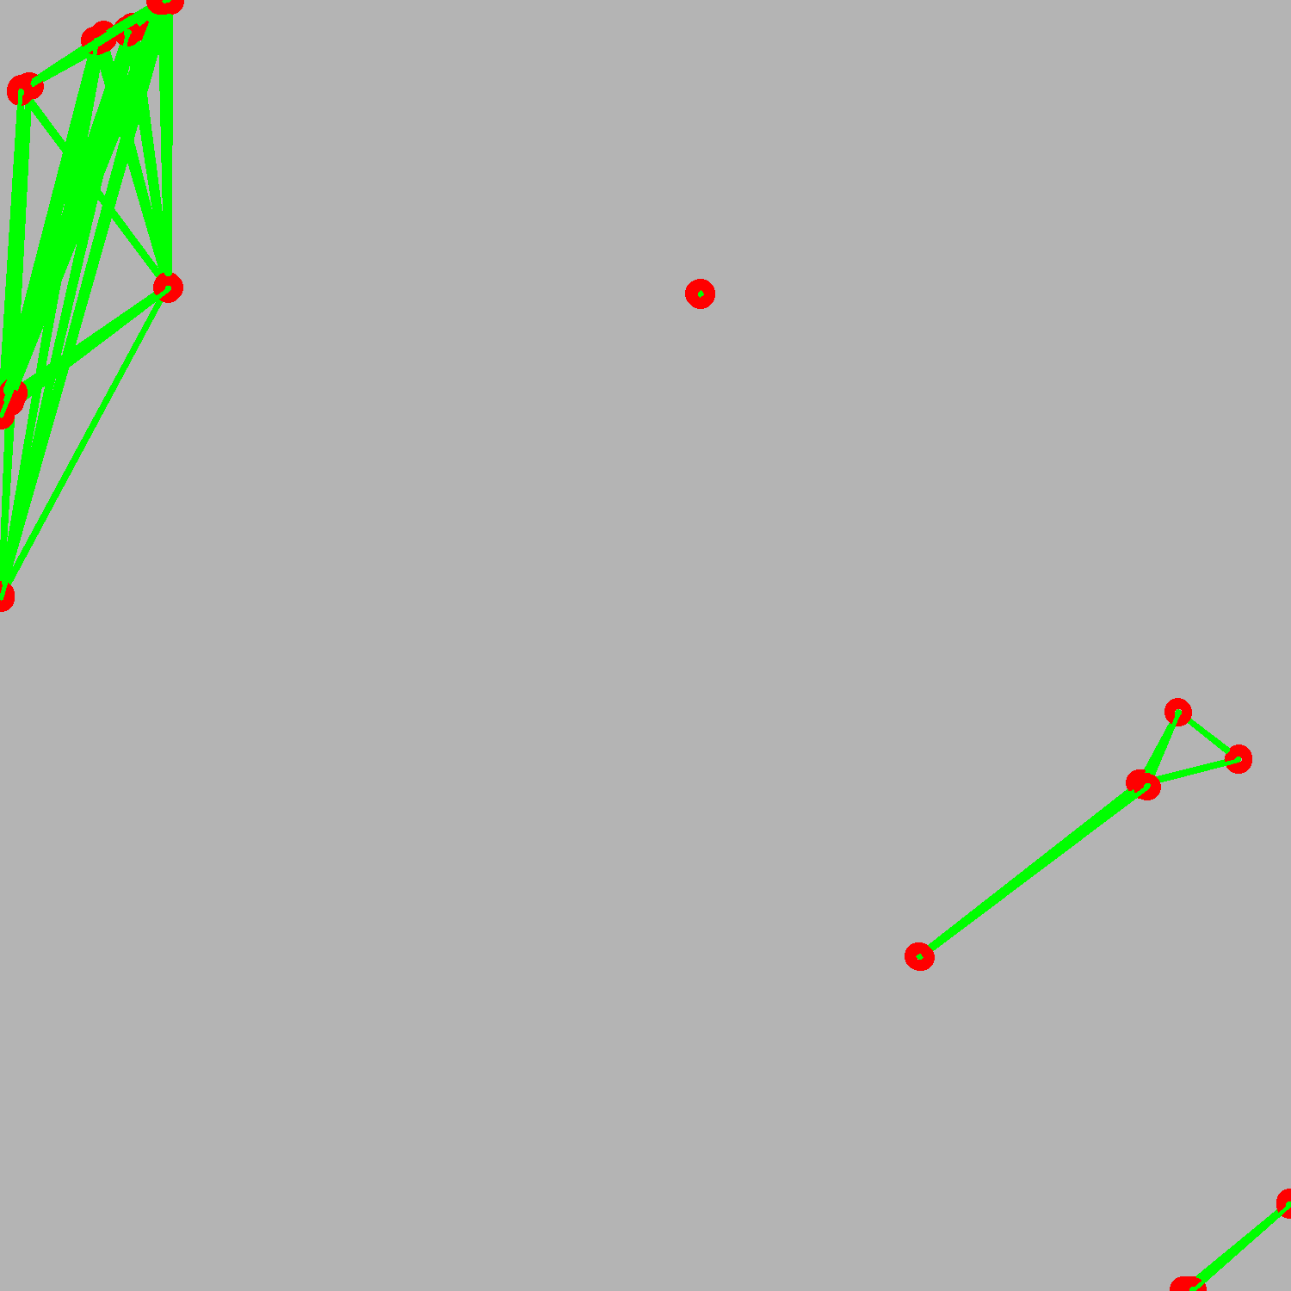
Crossroads detection + Making a graph: result-2

Slide 43

Crossroads detection + Making a graph: result-2

Slide 44
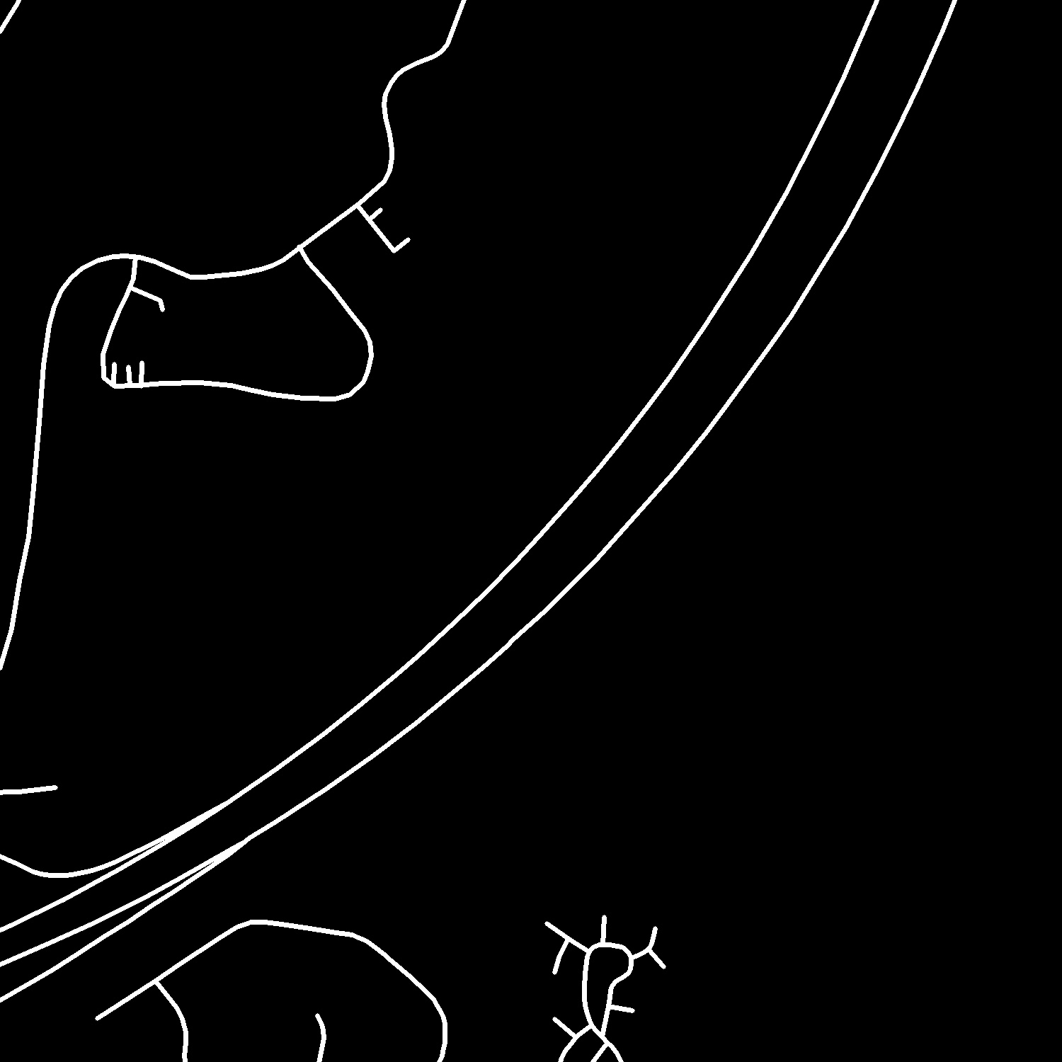
Crossroads detection + Making a graph: result-3

Slide 45
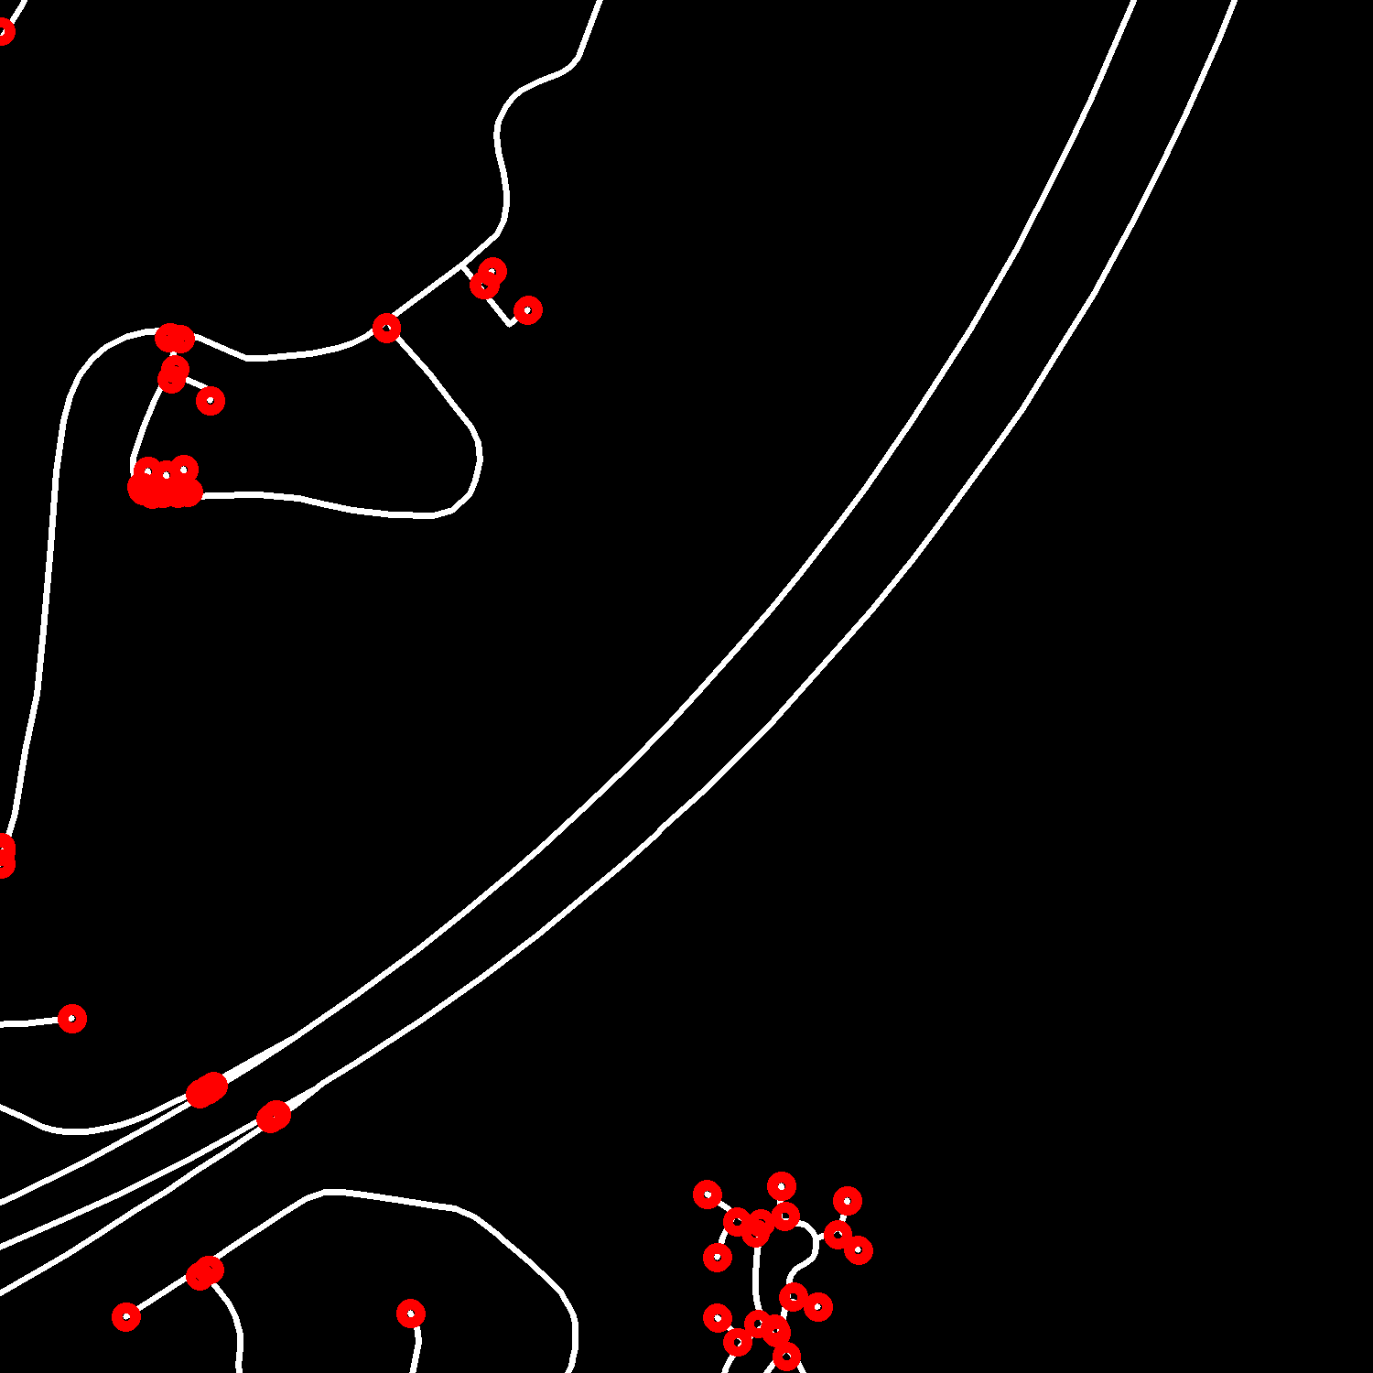
Crossroads detection + Making a graph: result-3

Slide 46
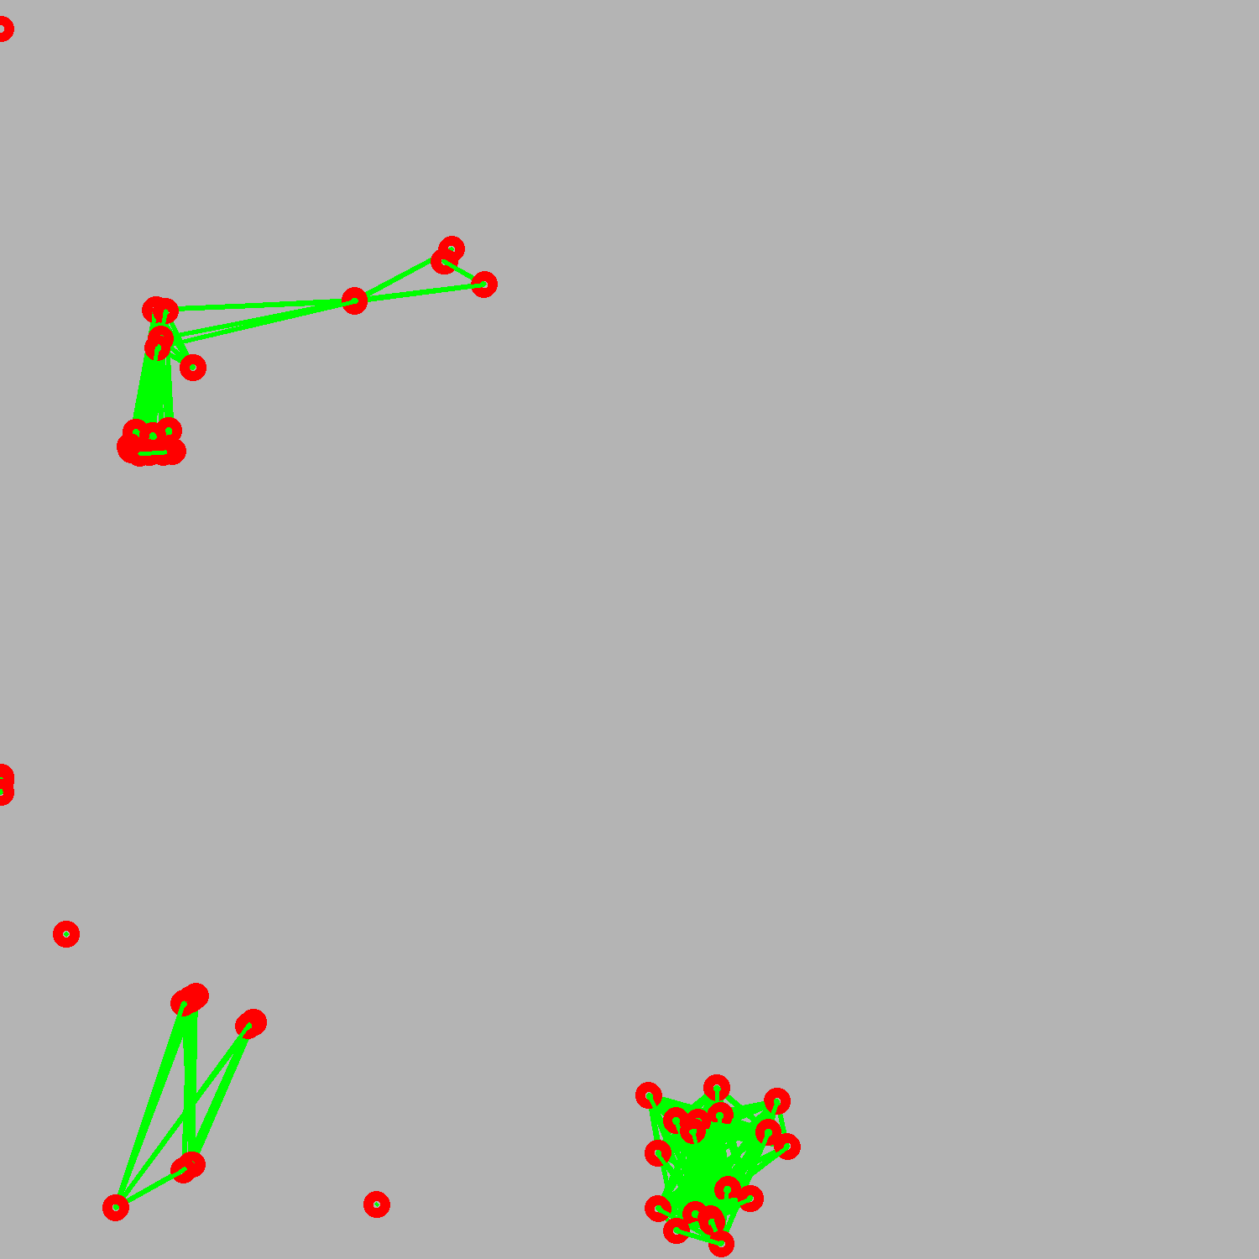
Crossroads detection + Making a graph: result-3

Slide 47

Crossroads detection + Making a graph: result-3

Slide 48
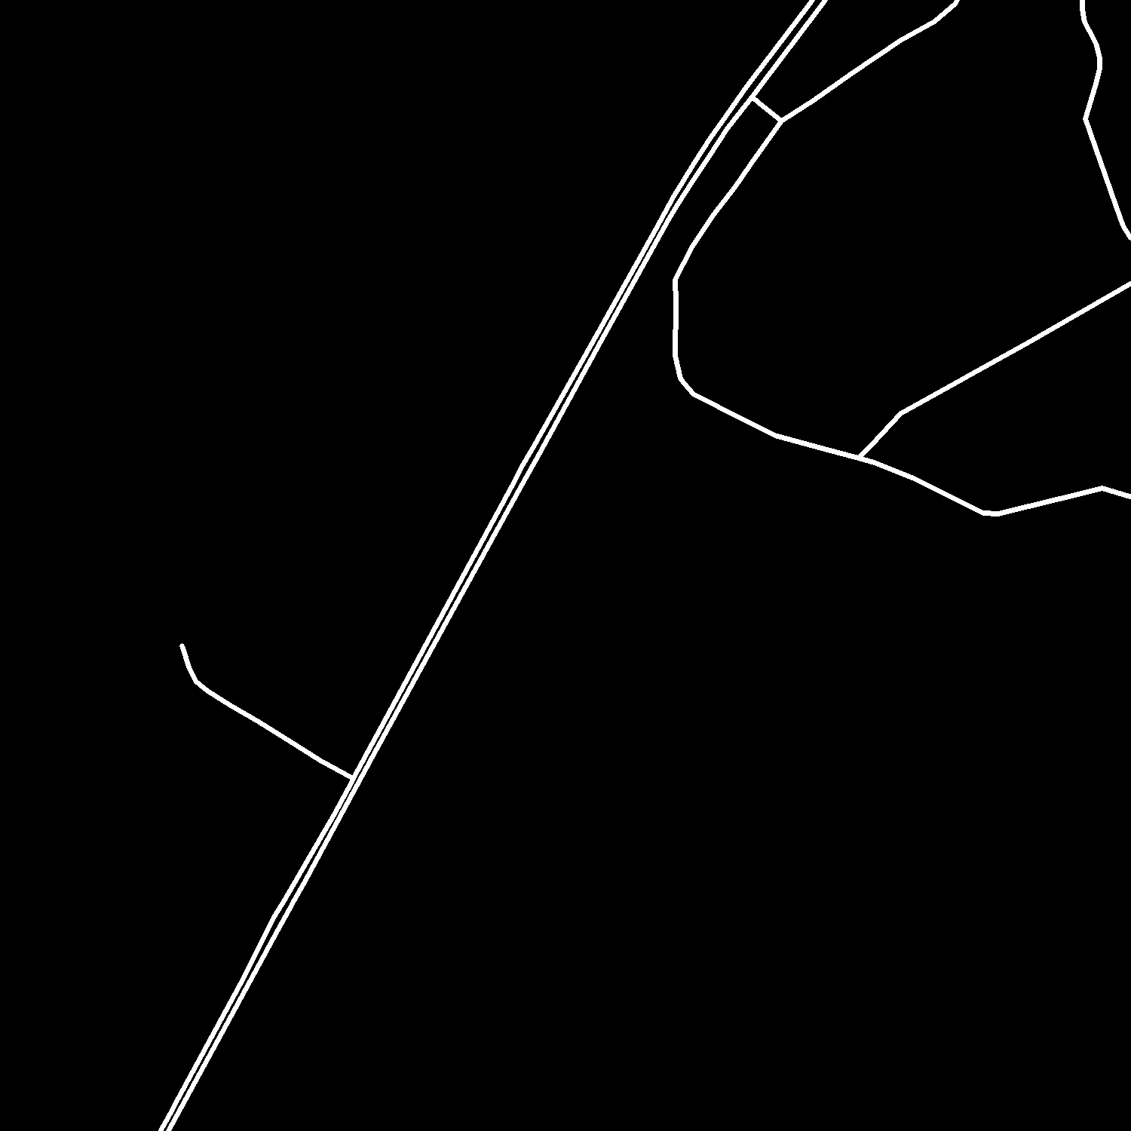
Crossroads detection + Making a graph: result-4

Slide 49
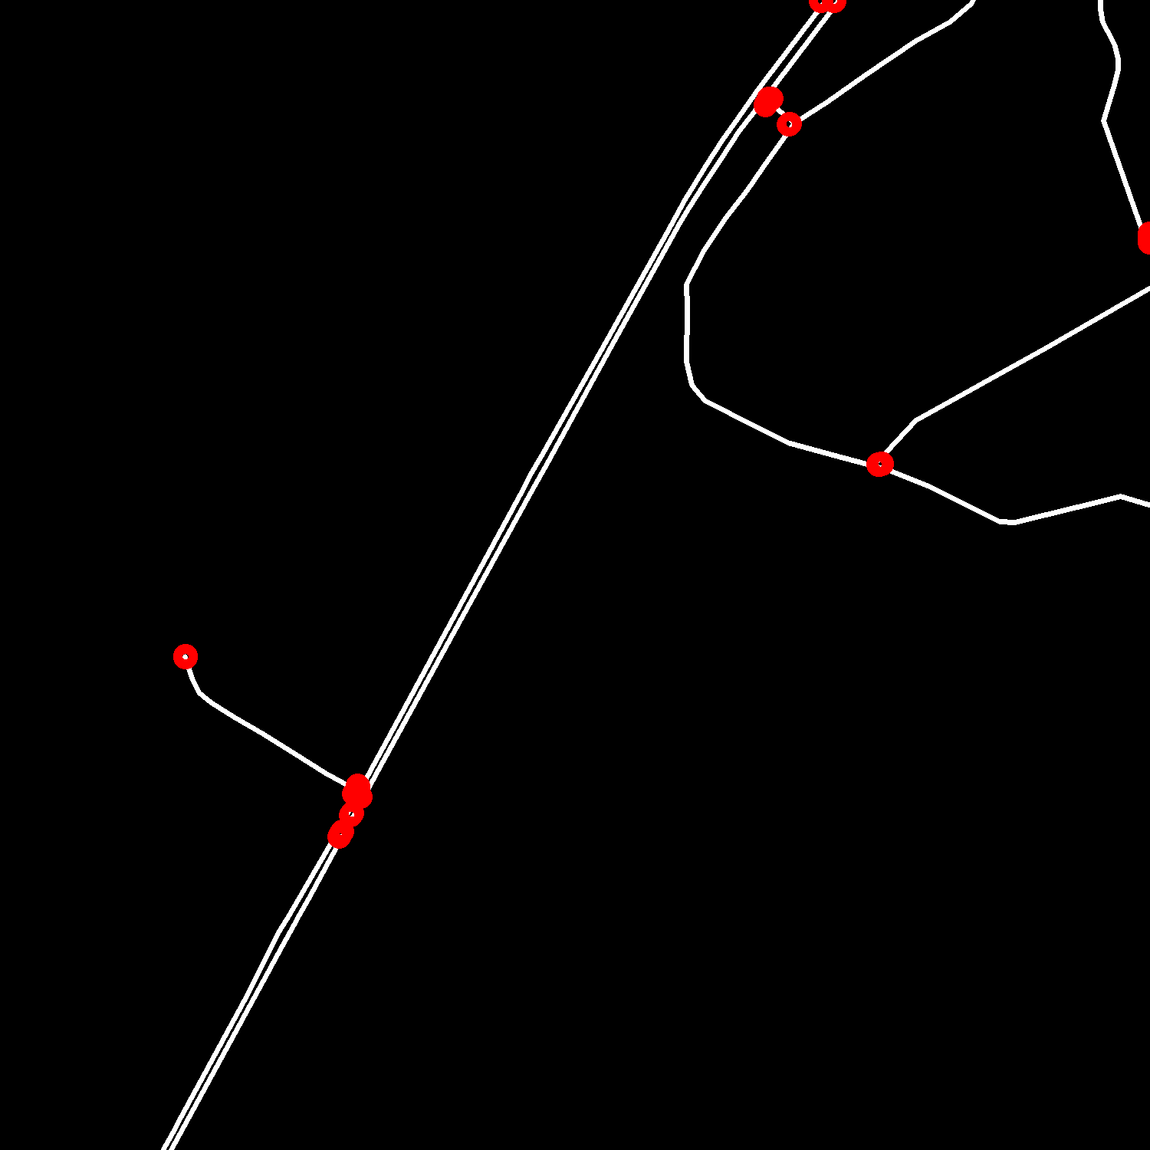
Crossroads detection + Making a graph: result-4

Slide 50
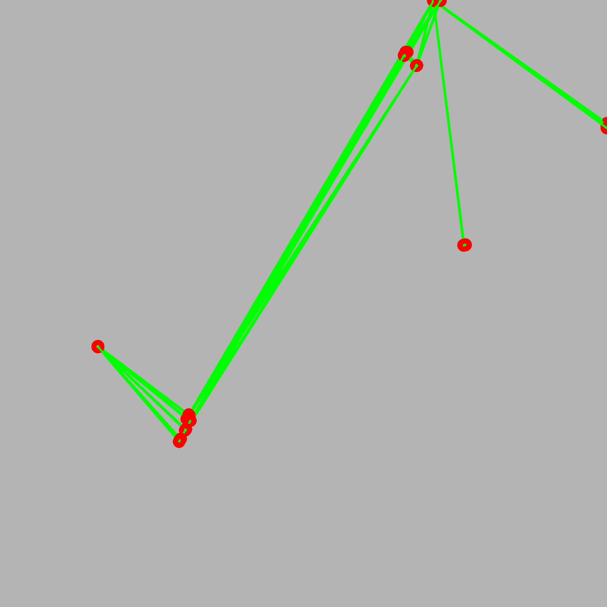
Crossroads detection + Making a graph: result-4

Slide 51
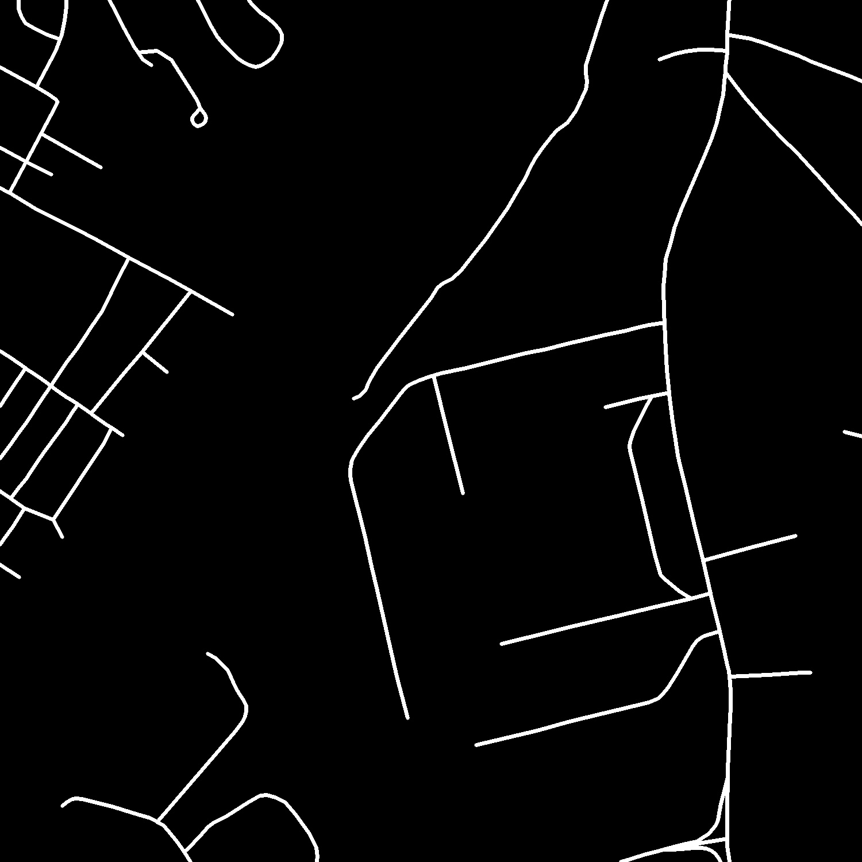
Crossroads detection + Making a graph: result-5

Slide 52
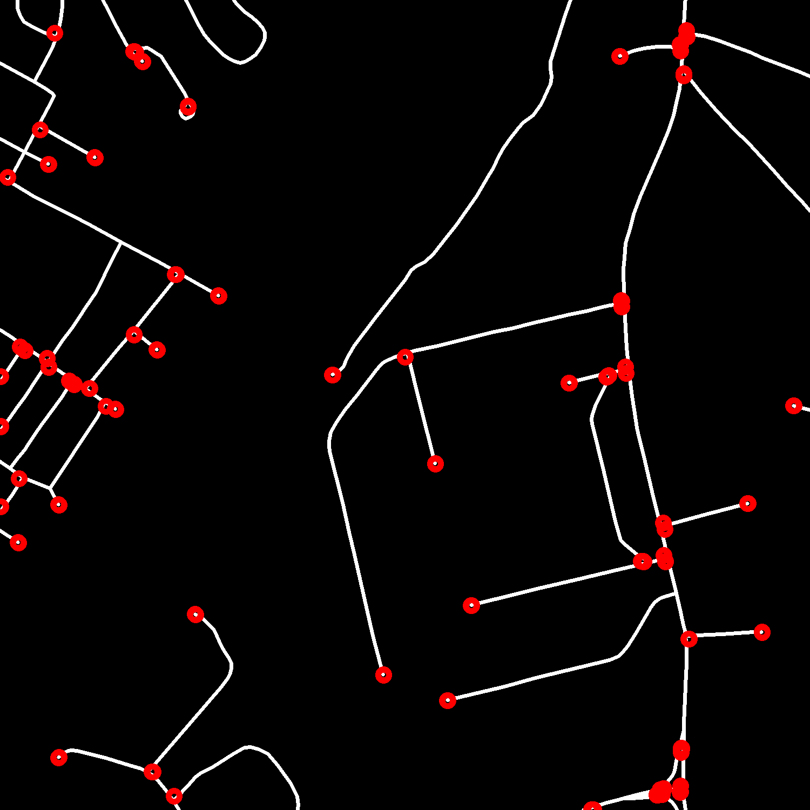
Crossroads detection + Making a graph: result-5

Slide 53
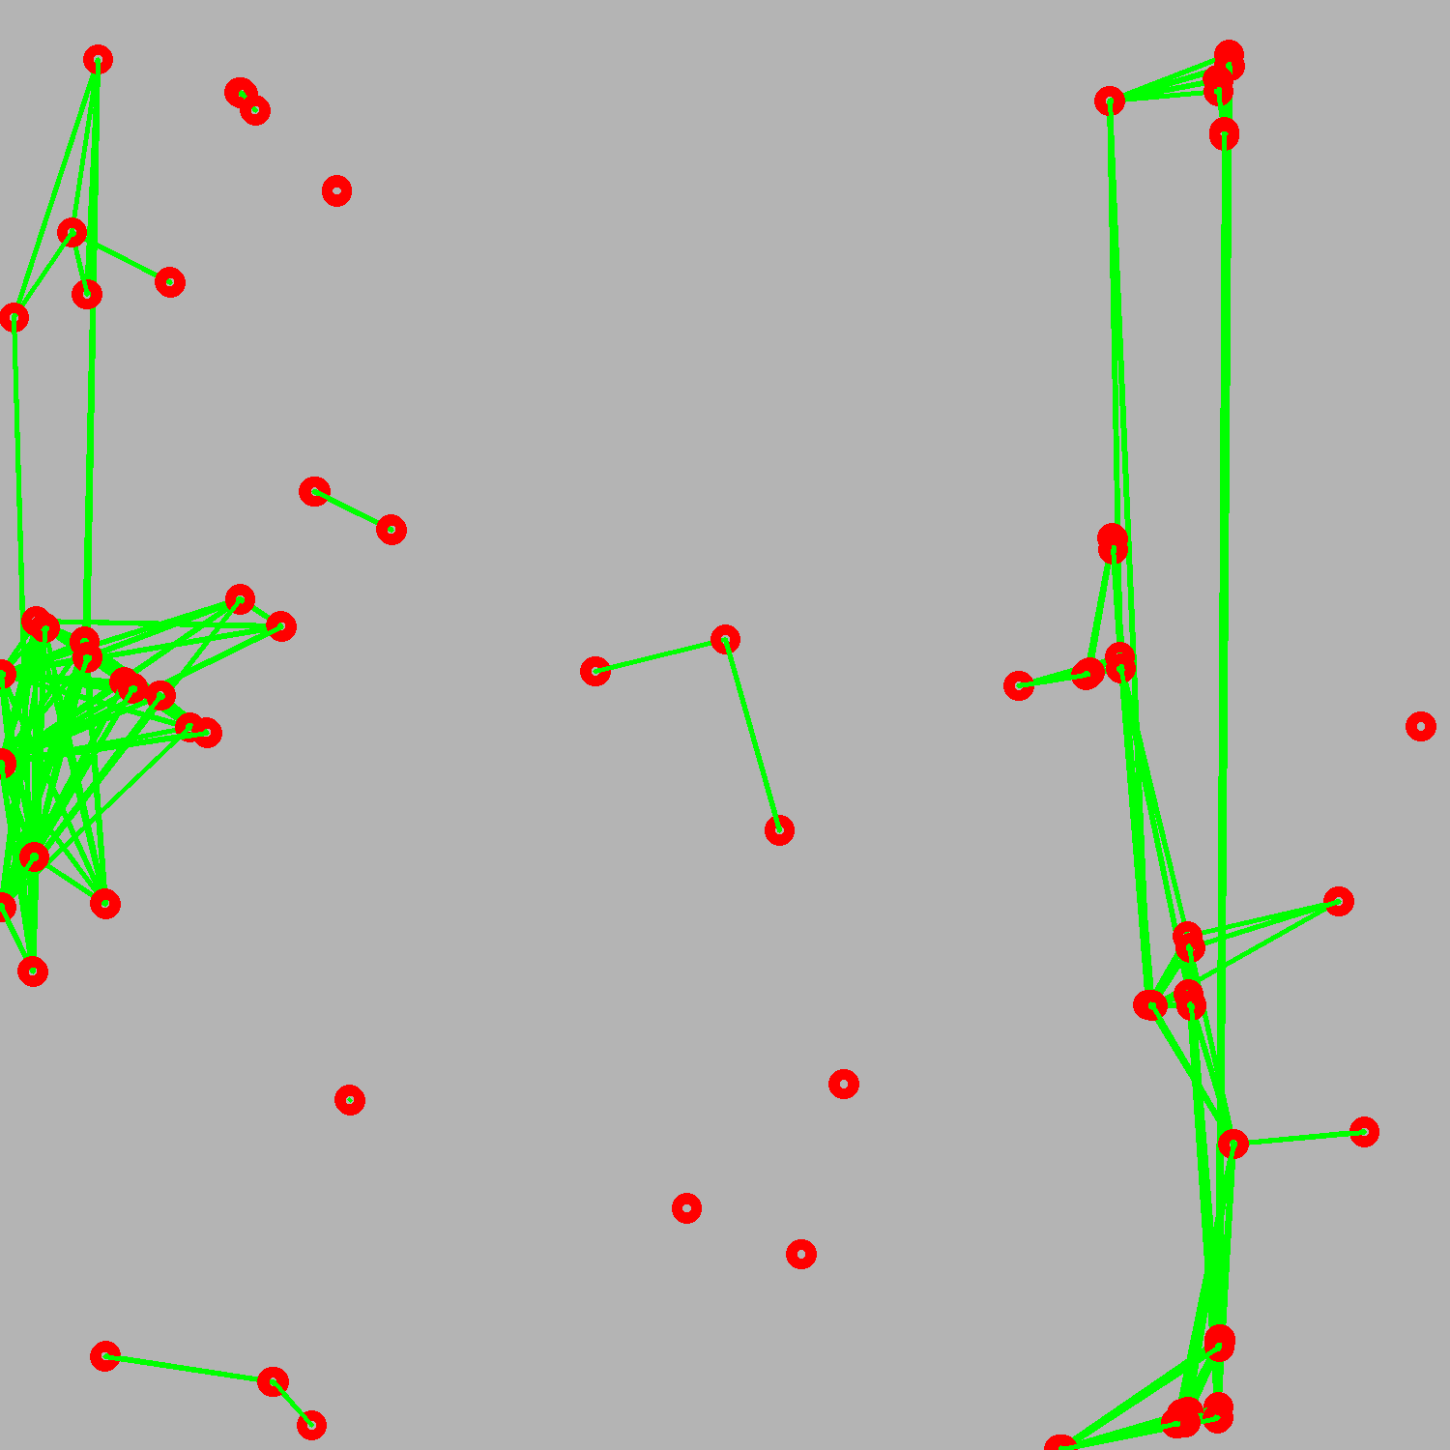
Crossroads detection + Making a graph: result-5

Slide 54
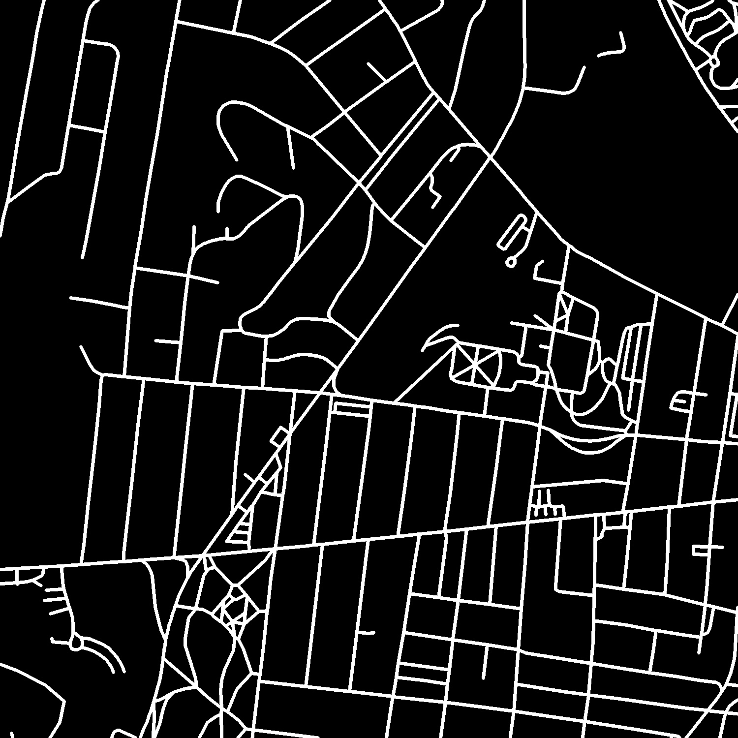
Crossroads detection + Making a graph: result-6

Slide 55
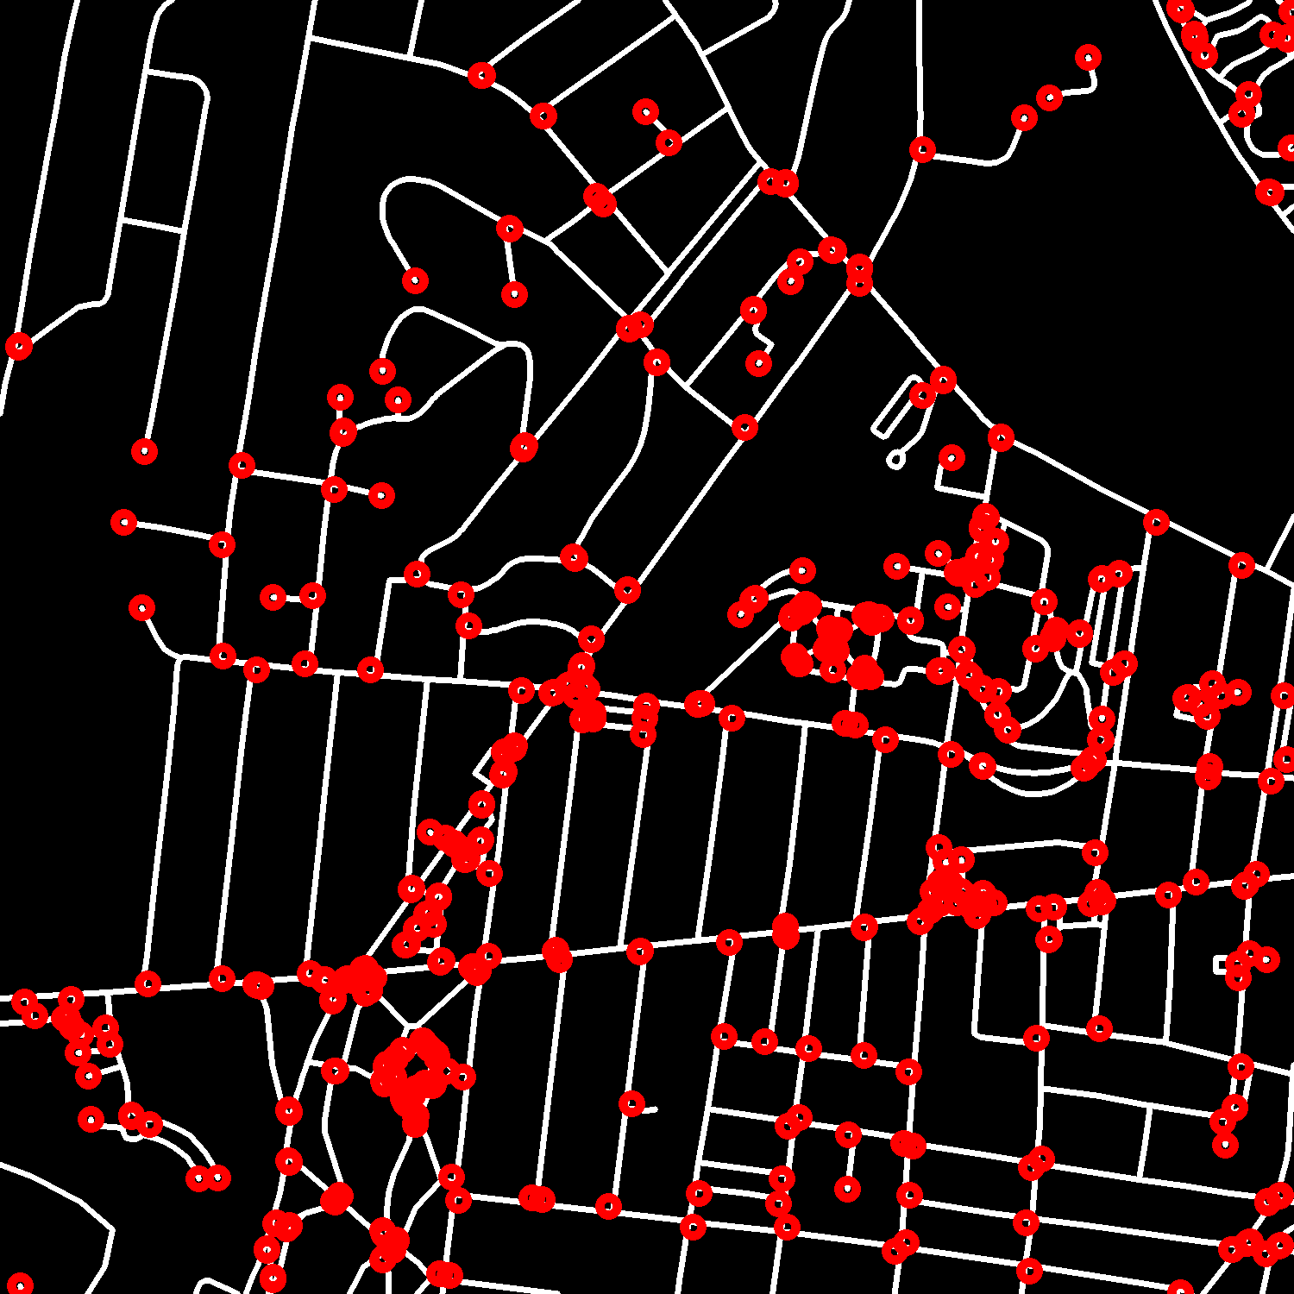
Crossroads detection + Making a graph: result-6

Slide 56
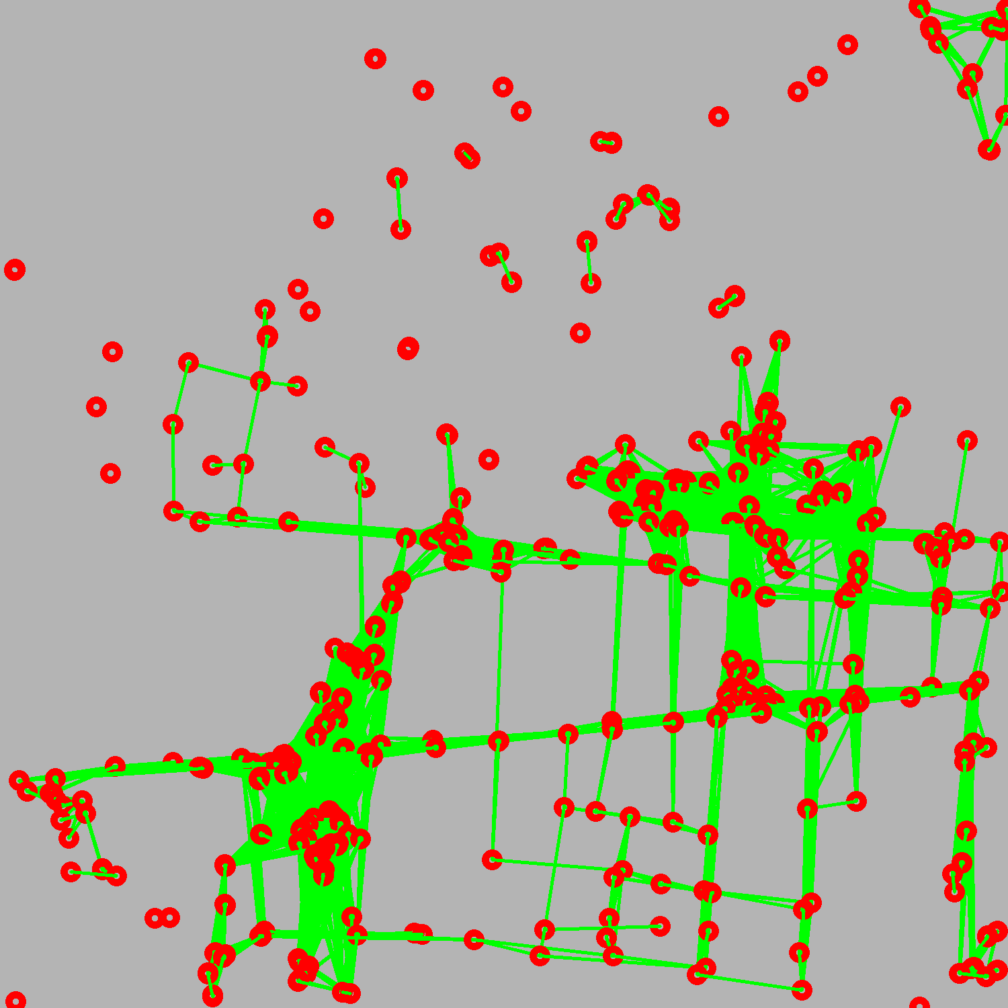
Crossroads detection + Making a graph: result-6

Slide 57
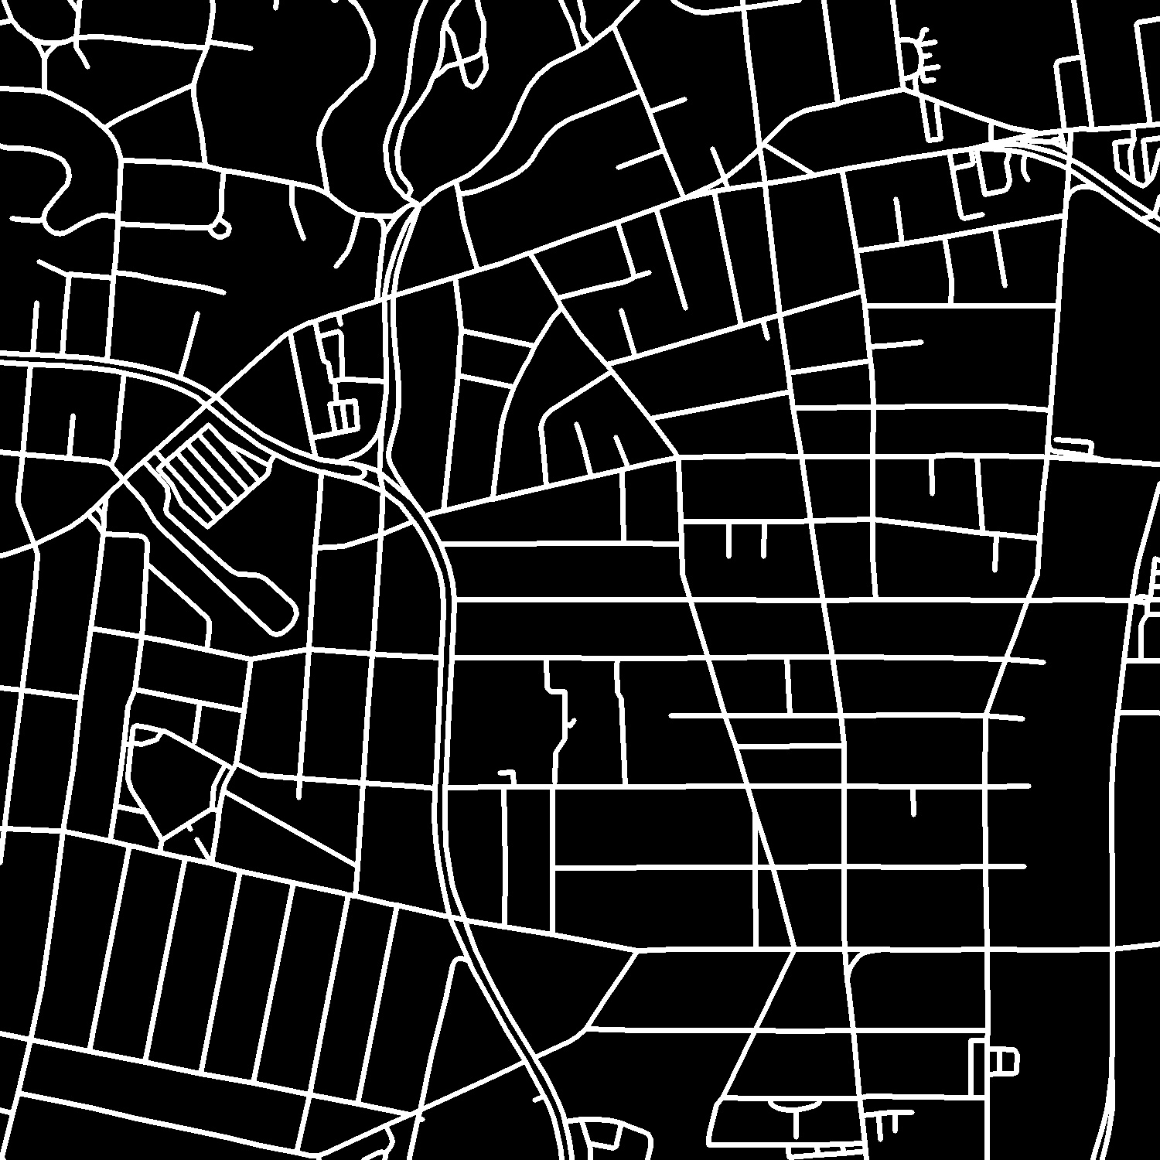
Crossroads detection + Making a graph: result-7

Slide 58
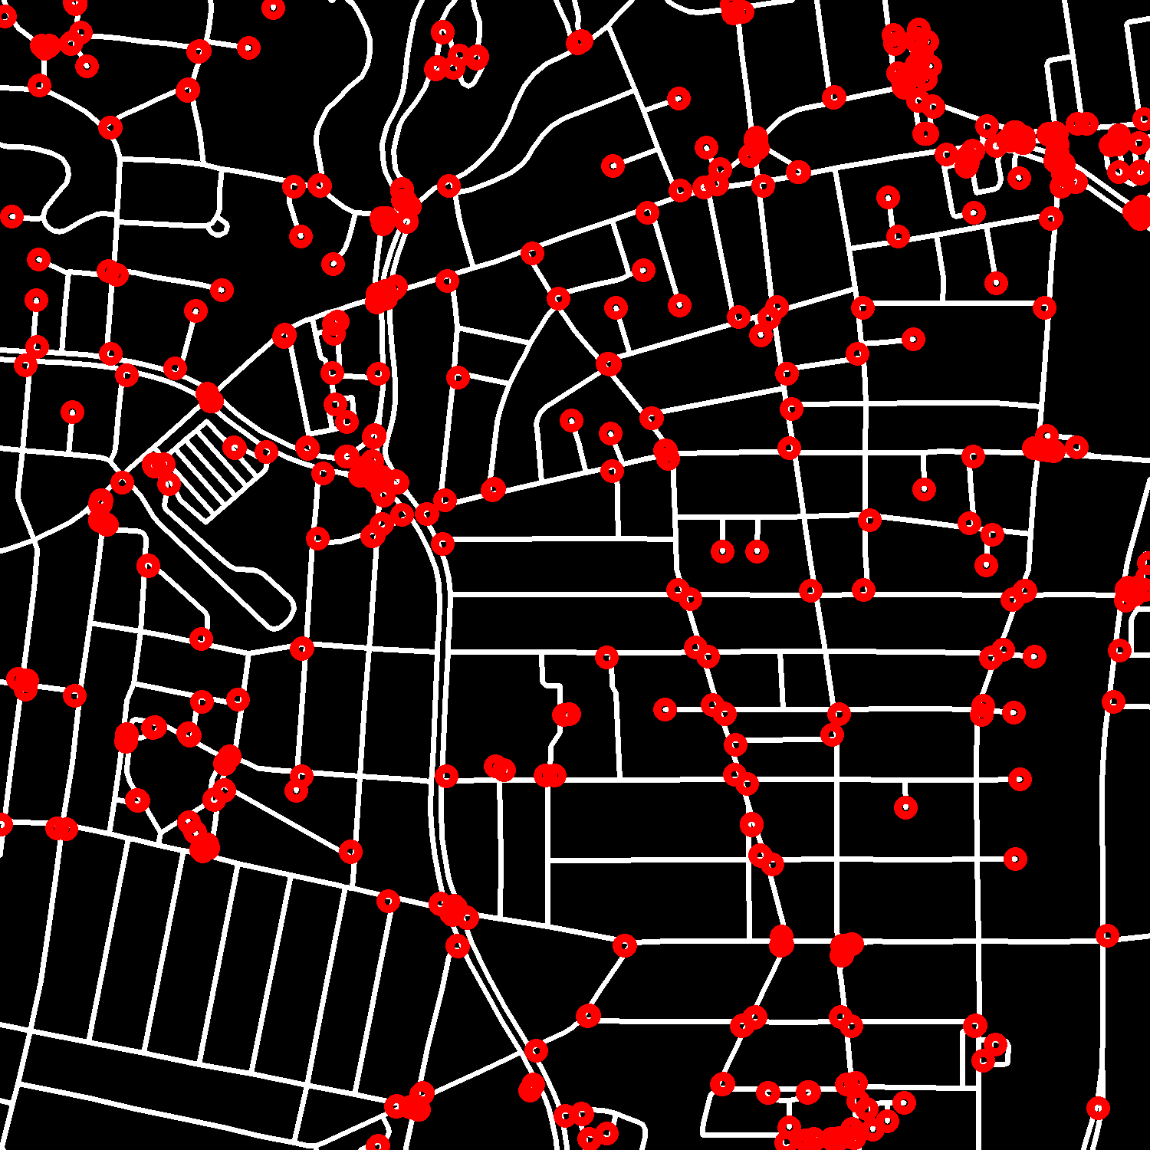
Crossroads detection + Making a graph: result-7

Slide 59
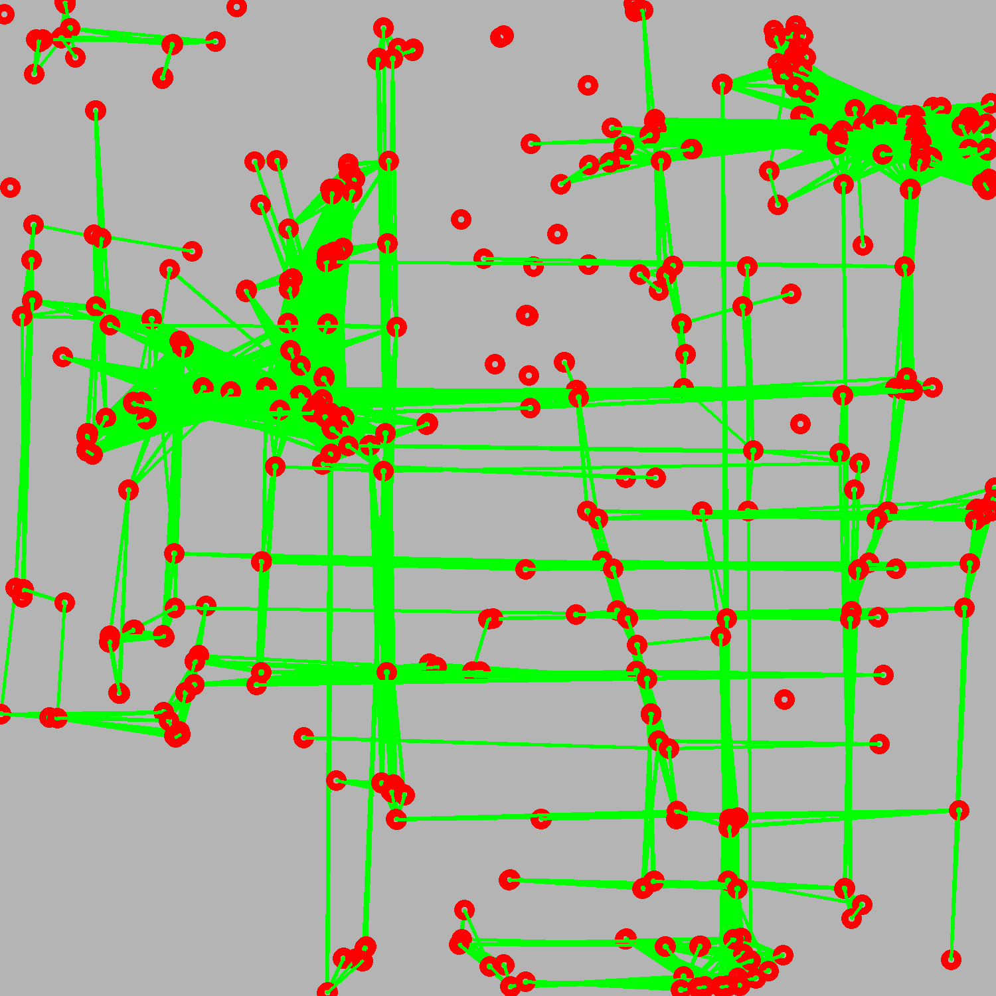
Crossroads detection + Making a graph: result-7

Slide 60
Спасибо за внимание

